Slide 1
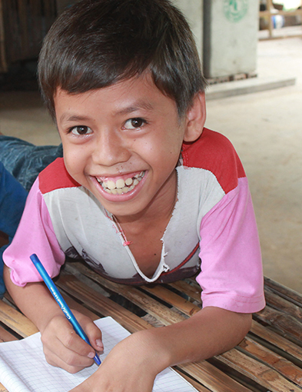


Emerging issues
in development: Areas for long-term thinking
Board of Directors
San Salvador
7 November 2017
from violence and exploitation

Slide 2

Emerging Issues in Development: Reading
NOTE: View in slideshow (press F5) to activate hyperlinks)
Generation Games: The Gates Report (The Economist, September 2017)
Gates Foundation Global Report (September 2017)
The End of the Golden Age (Development Policy Centre)
Migration and the 2030 Agenda (ODI)
Prevalence of violence against children (Global Partnership 1-pager)
PowerPoints from May 2017 Learning Day (Michael Gibbons, Lisa Witter and Jacob Parks)
Additional reading materials can be found in the Optional Reading Materials Section of the website
Notes:
http://c.ymcdn.com/sites/www.lano.org/resource/dynamic/blogs/20131007_093137_25993.pdf
https://www.vanguardcharitable.org/resource_center/strategic_giving

Slide 3

Emerging Issues in Development
AGENDA
I. Purpose of Session
II. Building a bridge between the Board/CEO Learning Day in May & now
III. Moving Forward - a 25-Year View
Notes:
1. Purpose of Session
Michael Rose to review purpose of session

Slide 4
Emerging Issues in Development
II. Building a bridge between the Board/CEO Learning Day in May & now
What were your conclusions since May?
What developments have occurred based on learnings in May?
Notes:
Meg

Slide 5
Huge scale poverty alleviation
Persistent poverty
Rising urban child poverty
Massive displacement
Growing inequality/vulnerability
 | Well-funded | Under-funded
Issues
Agencies
Notes:
Michael Gibbons, Wellspring Advisors
The macro-economic conditions which shape the child development ecosystem include:
Poverty alleviation - In the last 20 years, economic growth/development in China, East Asia, SE Asia, South Asia fueled by industrialization and manufacturing and further global integration has lifted hundreds of millions of children out of extreme poverty, but many face new challenges as this drive breaks up extended families and traditional child care patterns.
Sustained poverty - Poor economic conditions in many parts of Africa and Asia continue to trap tens of millions of children in extreme poverty, generating high levels of toxic stress.
Displacement - The massive humanitarian crisis in the Iraq, Afghanistan, Syria, Yemen arc has disrupted economic growth patterns in these and nearby middle income countries and displaced millions more children, and families, putting them at severe risk.
Urbanizing growth of child poverty – Africa is the fastest growing and fastest urbanizing region in the world, fueled by continuing high fertility and child survival rates, migration and displacement to cities.
Growing inequality - The growing internal inequality, slowed economic growth and retreat from equity-oriented policies in many high and middle income countries have situated millions of other formerly less vulnerable children in relative poverty and adversity.
Children’s issues funded relatively well: MCH and basic education (but big gaps remain), girls’ development
Children’s agencies funded relatively well: “Big 3” (UNICEF Save WV), Second tier big Western (Plan, CFA, AA, etc)
Under-funded children’s issues: SDGs generally, Family planning and RH, Children’s legal rights, Violence prevention, protection in armed conflict/displacement/refugee, adolescent girls RH
Under-funded children’s agencies: Local NGOs and CBOs by and large, regional and national NGOs, NGO networks at every level, specialized ‘niche’ INGOs
In other words, the funding and economic context of our work is complex, volatile and evolving. What can CFA do to respond creatively to these conditions?

Slide 6


Notes:
Systems view #2:
Lacey herself is an evolving child, perhaps the most astonishing complex adaptive “system” on earth. From a systems point of view, Lacey’s development is Holistic (multi-faceted as in the previous slide), Cumulative (as in this slide, consolidating previous gains as platforms for next phases of change) and Inter-connected (elements add up to ‘whole system’ whole child, in this case, Lacey). The science of child development is becoming clearer and clearer every day. In the 1990s, ChildFund as CCF pioneered efforts to synthesize child development science and use it as guidance for programming worldwide (see the CCF Child Development Index and Child Development Handbook.) Today CD science is much better known. Here are five key numbers that summarize the state of child development science today as synthesized by the Center for the study of the developing child at Harvard University:
1 million: in the first few years of life, 1m new neural connections are formed every second!
18 months: age at which disparities of verbal development begin to appear between children of very poor, working class and college educated families.
90-100%: the % chance of developmental delays when children experience 6-7 risk factors in the first three years of life.
3x more likely: adults who experienced adversity as children are three times more likely to suffer heart disease than those who do not.
$4 to $9 return: Heckman, Nobel macro-economist, has shown that for every dollar invested in good quality ECD programs, the return is $4-$9 over the lifecourse.
So science (not just morality, rights or charity) is on the side of ChildFund’s strategic focus on healthy multi-faceted child development.

Slide 7
Current funding reality 2017
ODA ups/downs
Philanthropy
Notes:
Current funding reality 2017:
I Official Development Aid (ODA) trends
Less funding:
Threat of US massive cuts to foreign aid (US is by far the largest foreign aid funder)
Slower or no growth of most Western donor commitments (due to slow econ growth, immigration crisis, neoliberal perspective, populism, etc)
Exceptions – modest education gains: modest increase in WB funding, Norway leadership on education SDG, Education Cannot Wait Fund, new EiE fund; strong sustained MCH funding
More competition for same slice of pie:
Proliferation of competing SDG-related social investment funds (old and new) – PEPFAR, Global Fund, VAC Trust Fund, GPE, social protection, almost all SDG goals and many targets setting up competing global fund mechanisms
Massive humanitarian crisis in/around Syria siphoning funds from other crises.
More directive restricted funding:
Less broad sustained budget support for LDCs
More competing theme funds
More donor government directed contracting
Less NGO/civil society funding, more technical expert funding
II Philanthropy trends
Privatization of capital: Since 1980, the acceleration of neoliberalism, globalized capitalism and resulting reduced resource flows through national governments concentrates more resources in private hands (corporate, hedge fund, individual), outside public institutions
Remittances: one feature of globalization is that funds from migrant diaspora sent home worldwide top all other flows of private and even ODA philanthropic funds to lower-income countries, and is mostly family, charity, religious, less strategic or systemic
Fragmentation/proliferation: More and more small philanthropic entities and campaigns, many online
Corporatism: Growth of national sovereign funds tied to corporatist states where political-corporate elite are merged and work in alignment
More and more diverse US/Euro philanthropy: rise of massive new wave of private western wealth from financial innovations, technology industry, new generation of entrepreneurs on steroids; following old-line institutional funders of earlier generation (Ford, MacArthur, Rockefeller, Carnegie etc), new BIG like Gates, Soros/OSF, Zuckerberg, Omidyar, Jobs, etc., and many next rank bigger philanthropic entities – Oak, GHR, etc. and new forms – Rockefeller Philanthropy Advisors, Geneva ??, Wellspring Advisors etc.
Regional diversification: Slow growth of Asia, Africa, LAC philanthropic mechanisms as economies grow (Mo Ibrahim, Elma Philanthropies, Alibaba, etc
More and better donor collaborations – Elevate Children, IEFG, African Grantmakers, etc
Contention and tension: tensions in philanthropy have always existed and are intensified in this polarized age - social justice/colonialism, poverty alleviation vs Cold War aims, new tensions in a multi-polar ideological spectrum of big and small private funders (conservative-progressive, inclusive-restrictive, Islamic-Christian-Hindu-humanist, rights/obligations-freedom, shared prosperity-individualistic competition etc).
Strategic engaged grantmaking: donor strategy and theory of change driving funding choices to a greater degree, less deference to local or technical grantees, more active donor engagement in strategy and choices, less general support and hands-off
Massive progressive resource mobilization: massive giving surge by citizens and institutional funders; examples ACLU, HRW, SPLC, etc
How can CFA build its fund-raising and donor influencing position and voice and credibility to exploit the opportunities and navigate the challenges in the funding sphere?

Slide 8
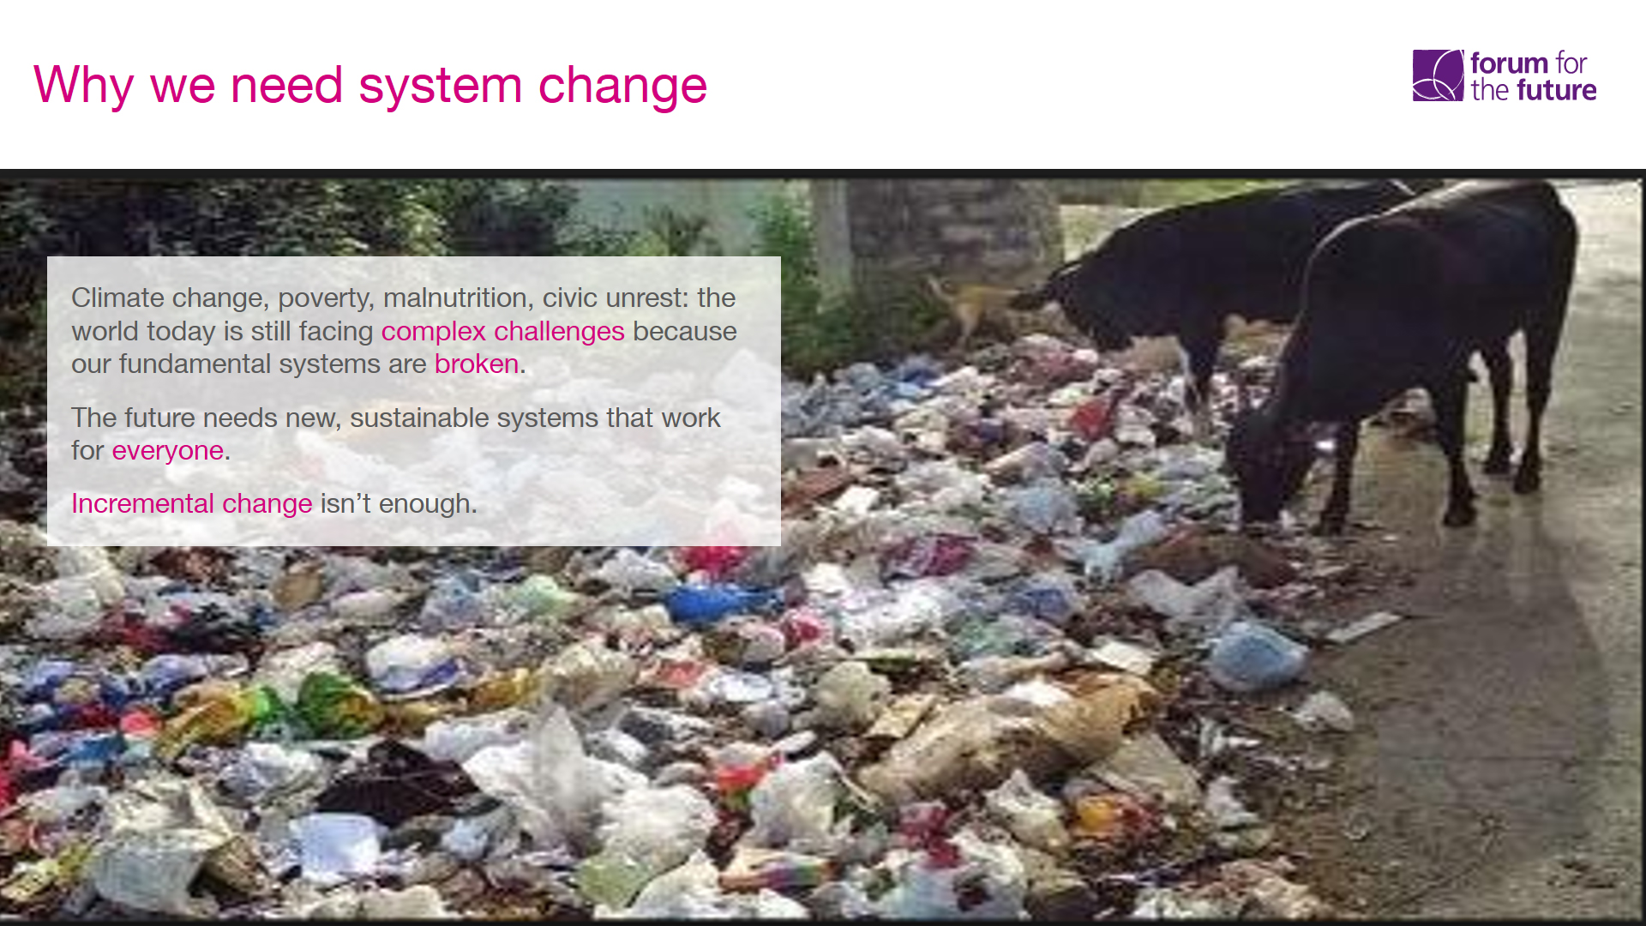
Notes:
Jacob Park, Forum for the Future.

Slide 9
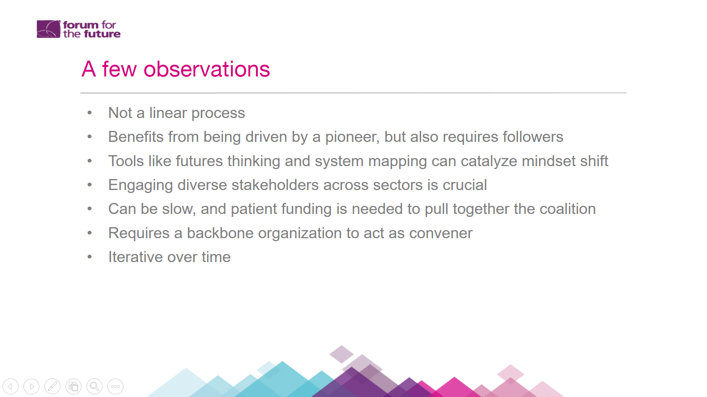

Slide 10
Notes:
Lisa Witter – social change strategist, entrepreneur.
Intersection among communications, government, philanthropy, technology, behavior.

Slide 11

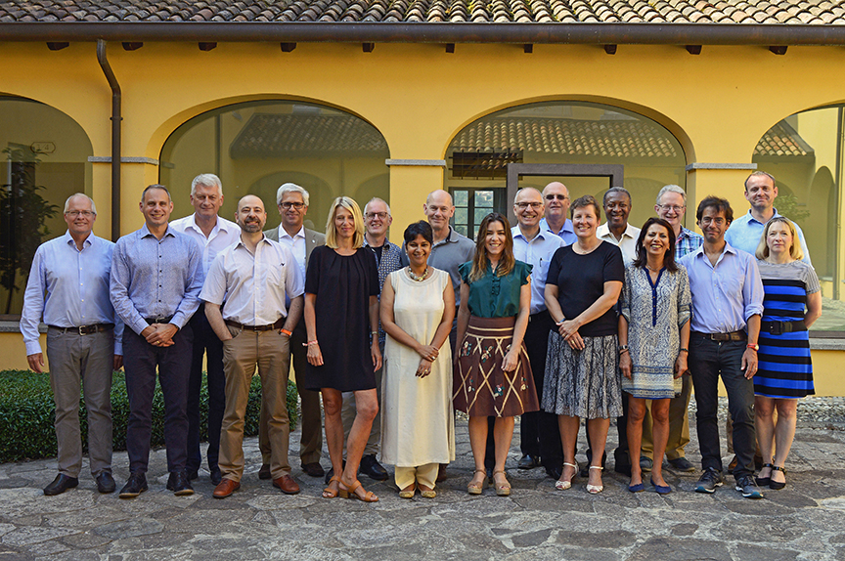
A new way of working together
Joining Forces for Children
Engagement with, Plan International, Save the Children, SOS Children Villages, Terre Des Hommes & World Vision
Notes:
“Joining forces to accelerate SDG implementation for vulnerable children”
Heads of six child-focused agencies (ChildFund Alliance, Plan International, Save the Children, SOS Children’s Villages, Terre des Hommes, World Vision)

Slide 12
Emerging Issues in Development
III. Moving Forward - a 25-Year View
Review of major global trends
Based on the readings (see slide 2) and other sources you’ve come across, what are the key challenges that are likely to confront us?
Are we well positioned to respond?
Notes:
Michael Rose

Slide 13
Emerging Issues in Development
Key questions:
1. What are the changes in our global development sector?
2. What do these changes mean for our members?

Slide 14
Emerging Issues in Development
Key questions:
3. How can the Alliance assist members in responding to changes in the sector?
4. How do we meet the desire for greater scale and collaboration in the sector?

Slide 15
Emerging Issues in Development
Key questions:
5. What does the Alliance need to look like to assist members?
6. How do we fund the Alliance so that it adds the most value for members?

Slide 16
Emerging Issues in Development
Key questions:
7. What do your local boards need to know about the Alliance – to see it as a resource rather than just a cost?

Slide 17
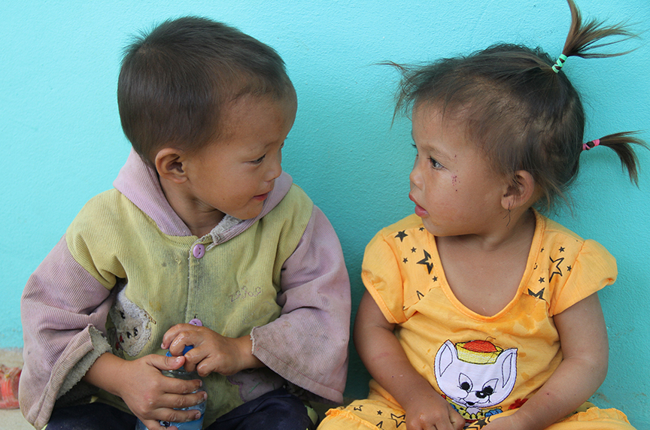
“Success is where preparation and opportunity meet.”

