Slide 1
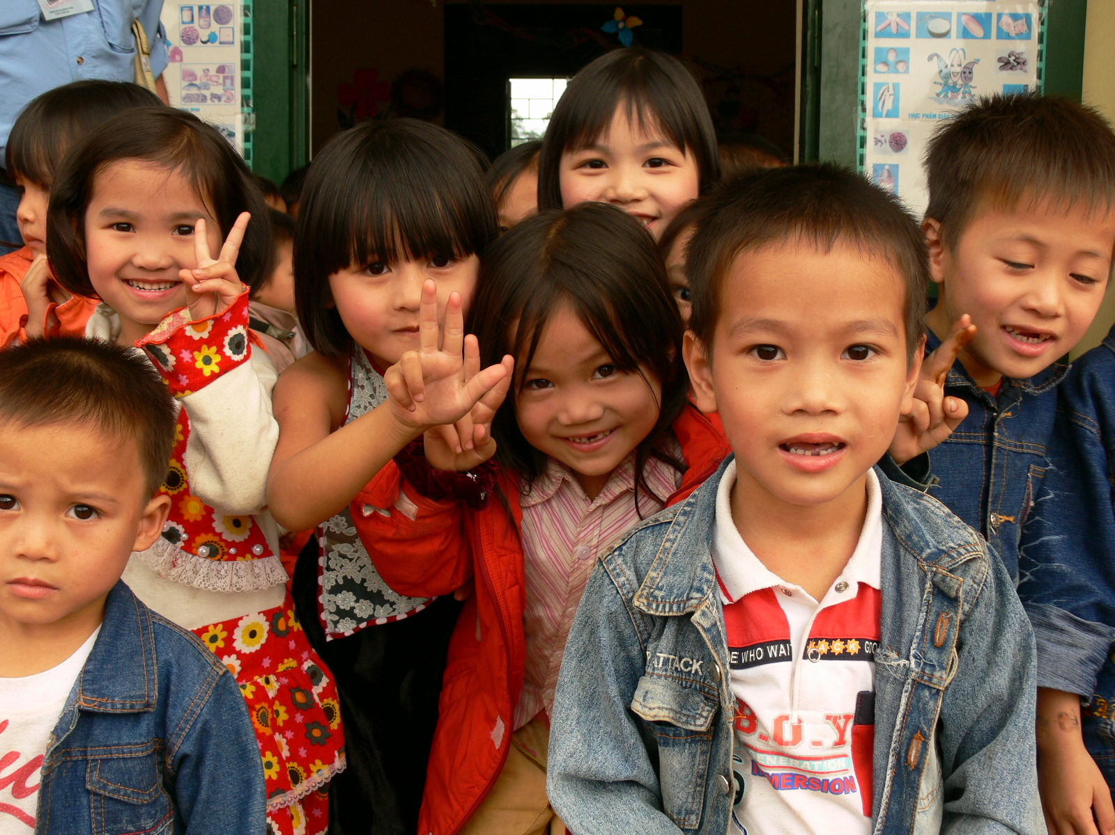
UN ENFANT PAR LA MAIN Hello Bar : a solution to increase the effectiveness of our website

Slide 2
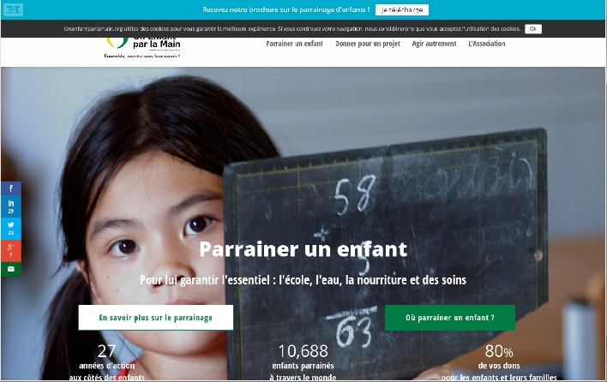
HELLO BAR- a plugin for 15$/month
Our new digital test to drive traffic and collect emails to convert more visitors into donors
Few days ago, Un Enfant par la Main has chosen to integrate 3 banners in its website www.unenfantparlamain.org
1
1st goal : get opt in contacts by leading visitors to download our presentation leaflet.
The banner automatically appears on the top of the screen, then the visitors are offered to give their names and email addresses to download the leaflet
10 days of testing
10 773 views
110 clics
1% Conversion
rate

Slide 3
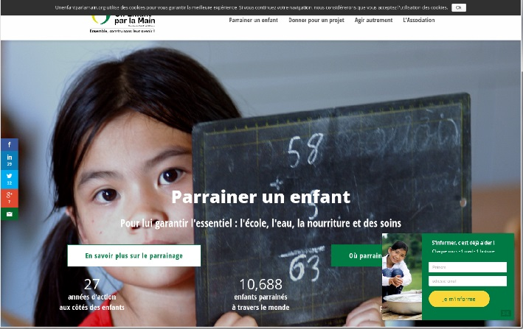
2
2nd goal : get opt in contacts by leading visitors to subscribe to our newsletter
33 days of testing
23 624 views
67 emails collected
0,3% conversion
rate
The banner automatically pops up in the middle of the screen, after 5 seconds

Slide 4
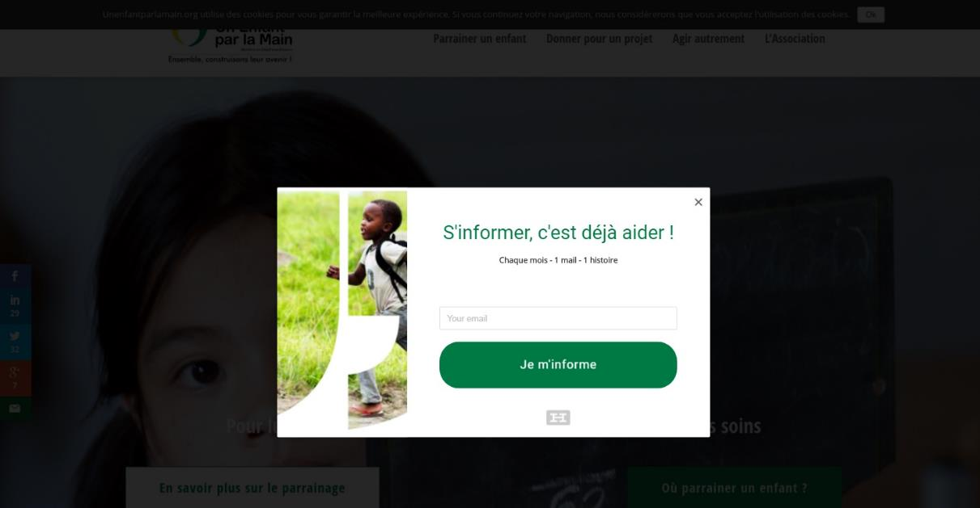
3rd goal : get opt in contacts when visitors to subscribe to our newsletter
3
26 days of testing
34 120 views
200 emails collected
0,6% conversion rate
The banner automatically shows up in the middle of the screen when the visitor intends to leave the website

Slide 5
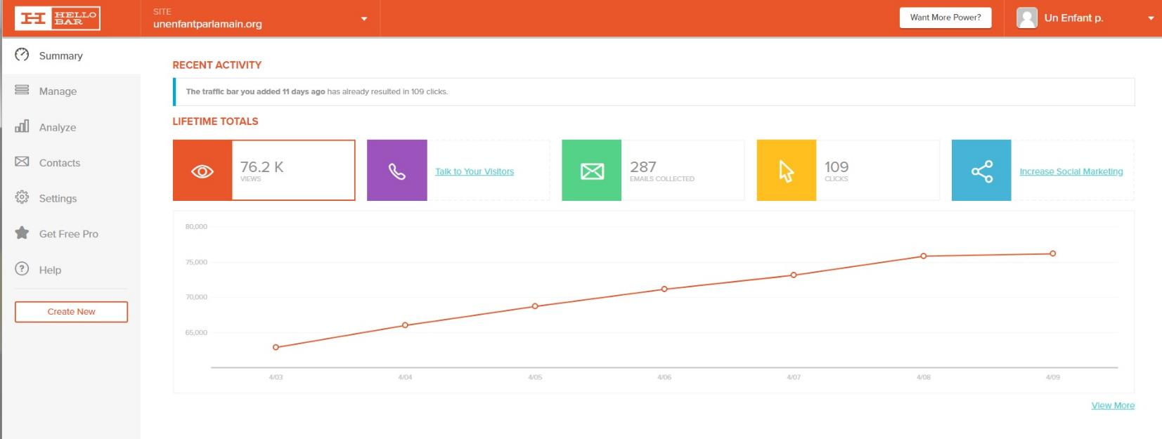
Our results so far
In one month of testing
FYI about HELLO BAR
We can create the pluggin as we want : color, image, typography !
The opt’ins are implemented directly on Mailchimp (our marketing automation tool).

