Slide 1
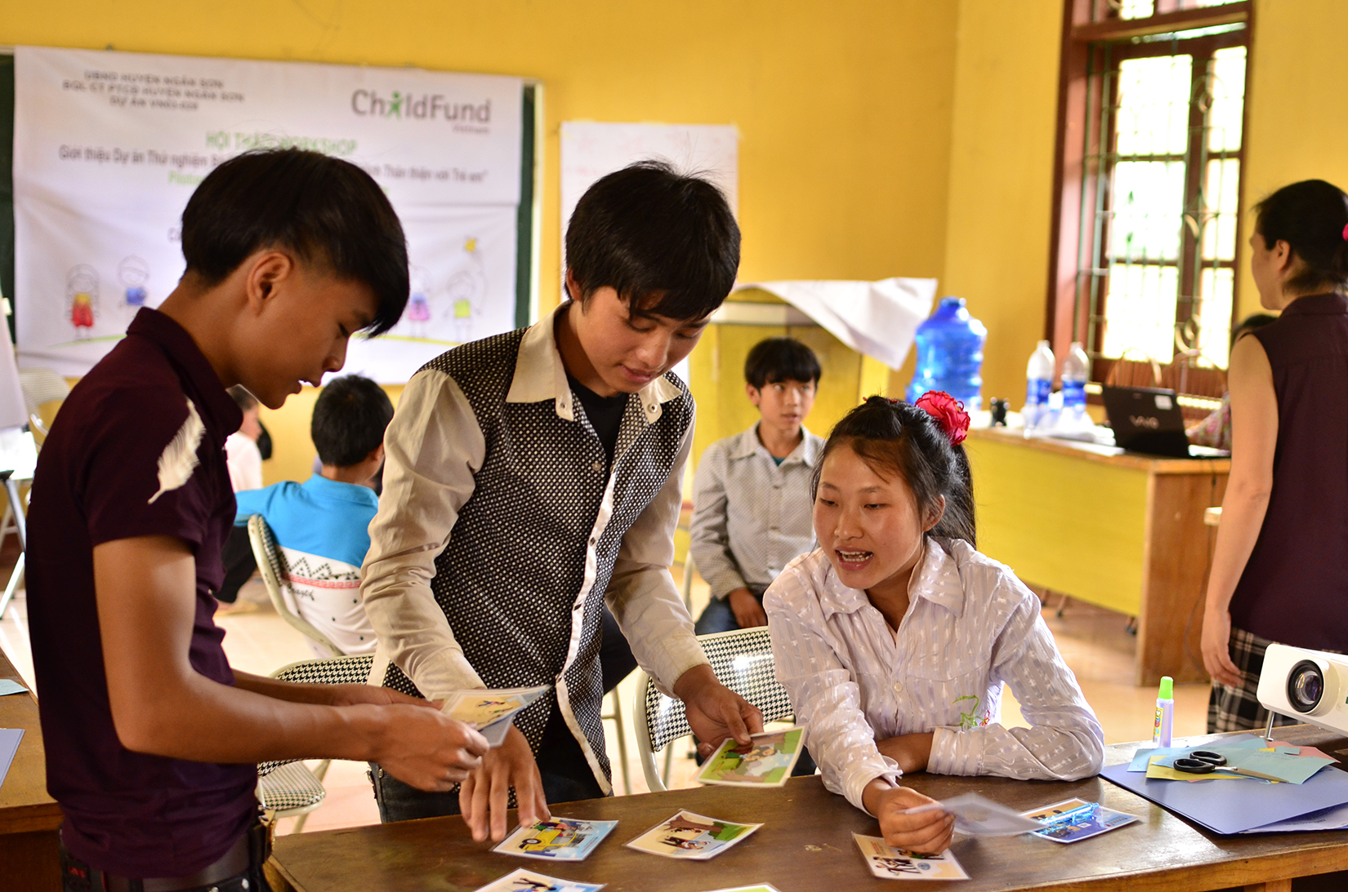
Prevention. Protection. Participation:
Addressing SDG 16.2 through
Child-friendly Accountability
Briefing, 19 September 2017

Slide 2
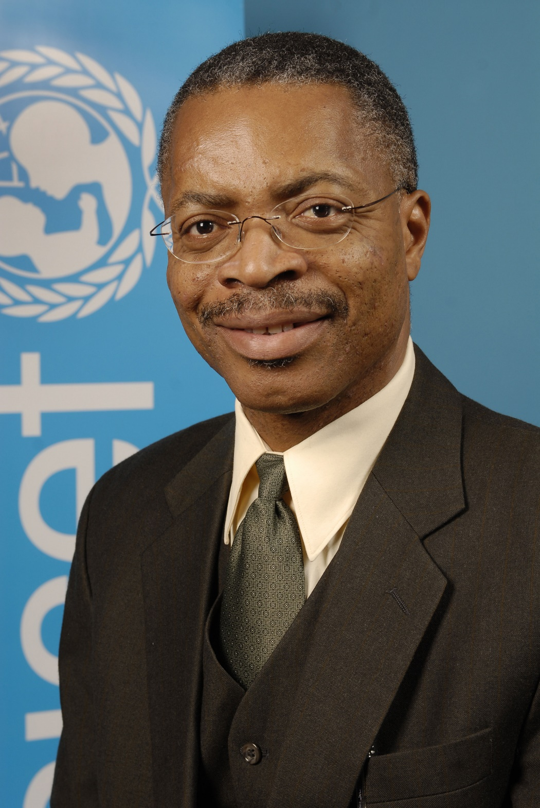
Dr. Nicholas Alipui

Slide 3
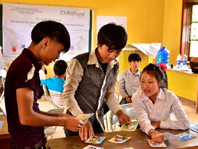
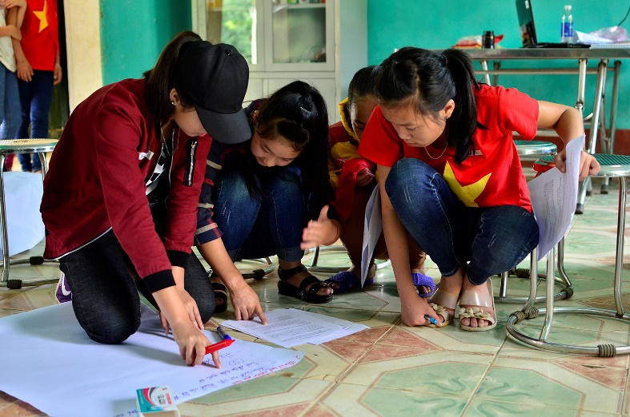
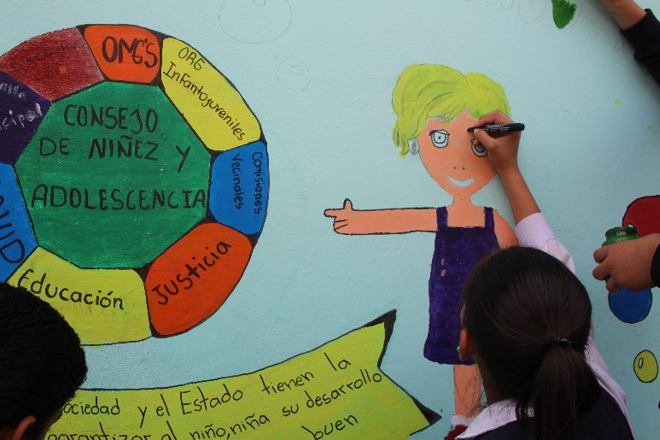
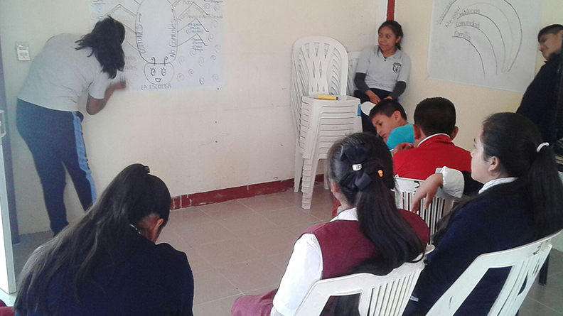
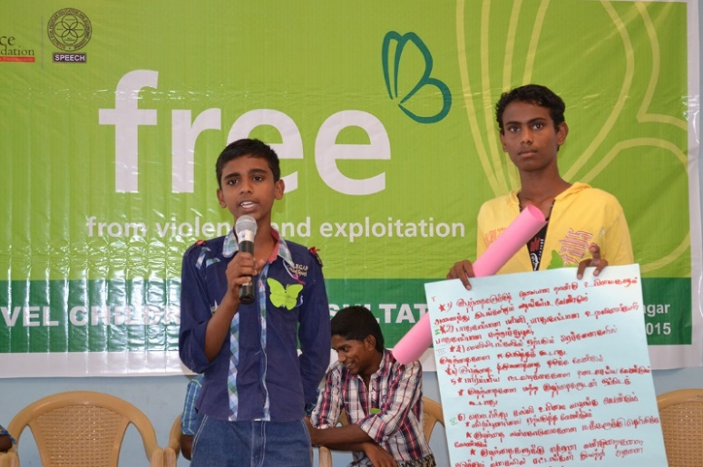
Findings from the Pilot Projects
Pilots have been highly successful. We are on the right track.
Paraguay
Vietnam
India
Mexico
Notes:
These have been highly successful pilots. We have learned that we are on the right track.
Quite frankly, we have all been thrilled with the results of the four country pilots. Not only were children & youth excited about participating and engaged in all parts of the pilot, they were able to achieve concrete change within the 3-month period of the pilots. In all countries, the children & youth are eager to carry on working together on child protection and have requested that Child-friendly Accountability projects continue.

Slide 4
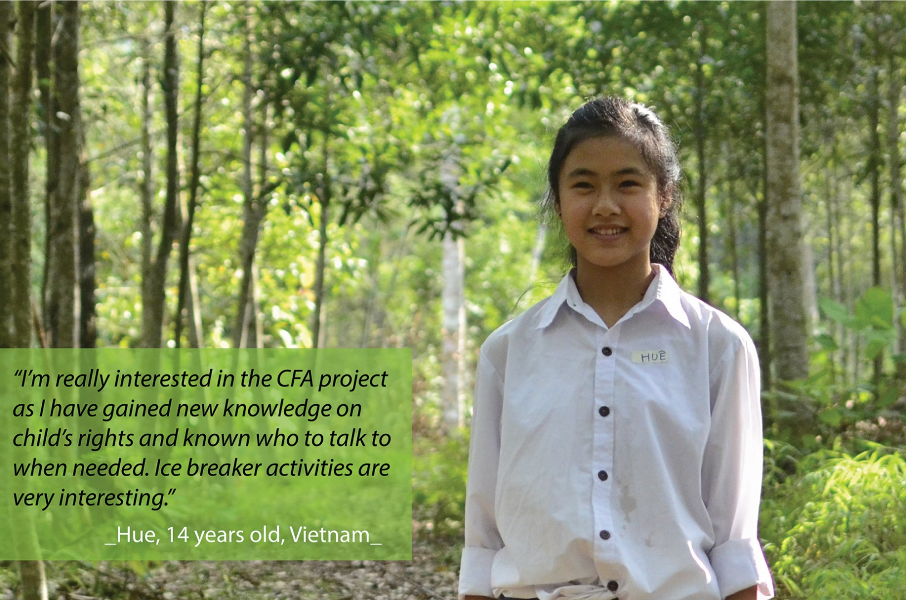
Findings from the Pilot Projects
Children & youth have been excited about participating in the pilots in all 4 countries and took exceptional steps to make sure that they were able to participate.
I’m really interested in the CFA project as I have gained new knowledge on children’s rights and know who to talk to when needed.
Notes:
Children & youth have been excited about participating in the pilots in all 4 countries and took exceptional steps to make sure that they were able to participate.
Example: girl in Vietnam who got up at 5:00 a.m. and walked 5km to join CFA activities.

Slide 5
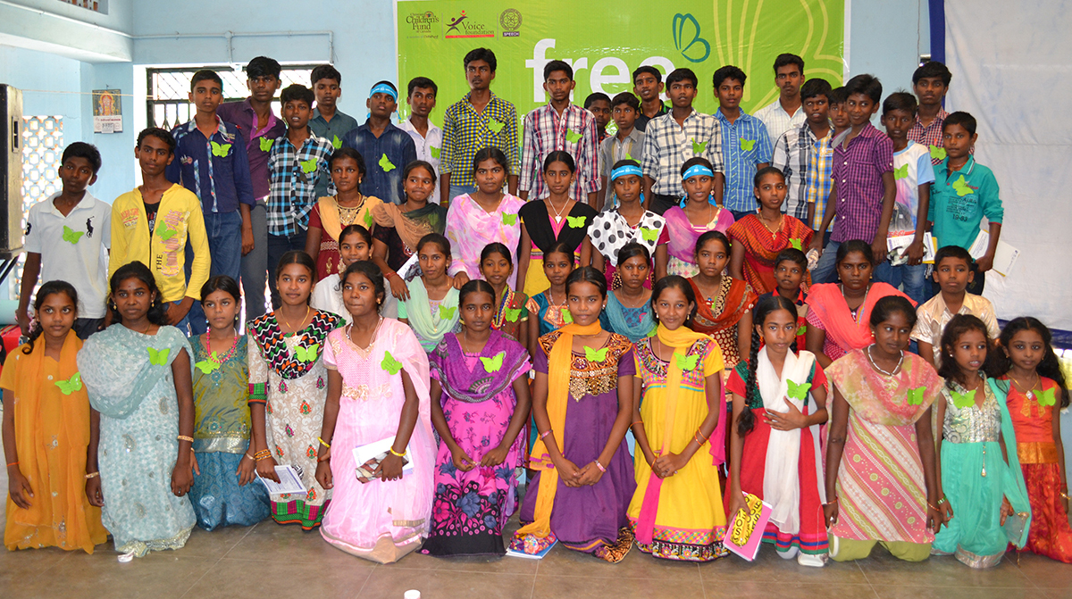
Findings from the Pilot Projects
Child-friendly Accountability activities brought children together.
Notes:
Child-friendly Accountability activities brought children together.
Example: In India children from different castes were able to overcome their discrimination and work together

Slide 6
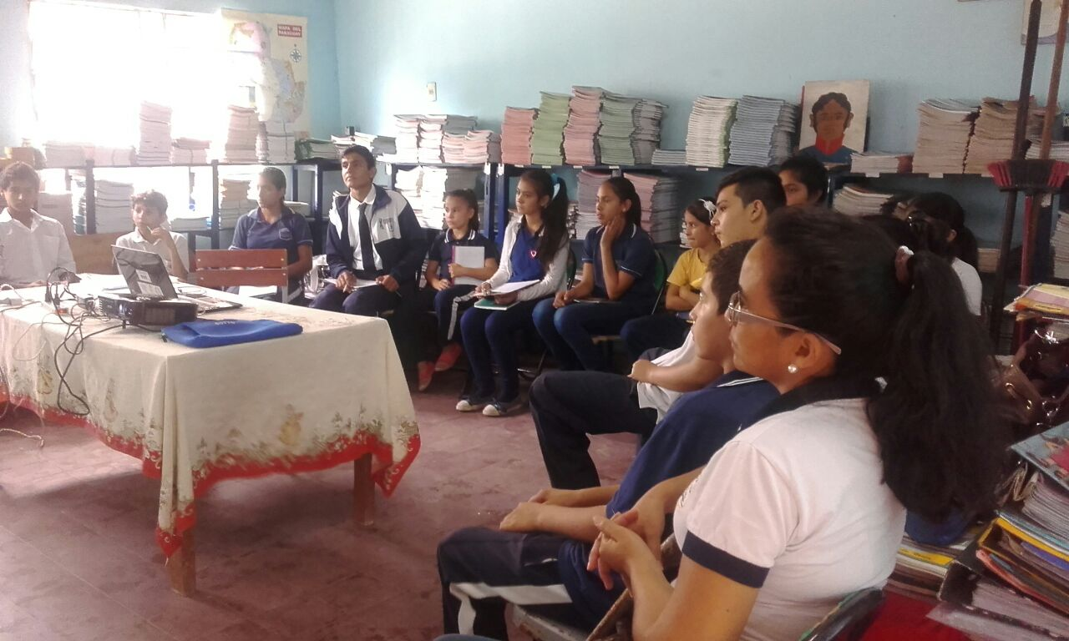
Findings from the Pilot Projects
In all countries youth and adults saw significant increase in knowledge about the universality of child rights and child protection.
Notes:
In all countries youth and adults saw significant increase in knowledge about universality of child rights and child protection.
Example: In both Paraguay and India children organized ‘information’ sharing sessions for their peers (and teachers) on child rights and child protection, as a result of participating in CFA activities

Slide 7
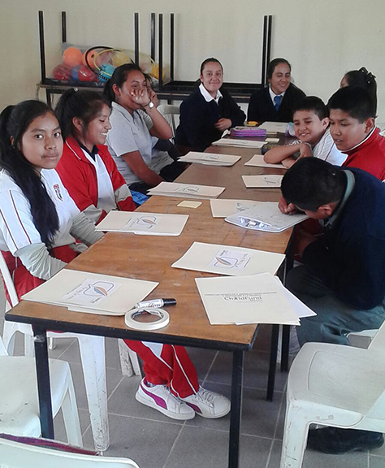
In all countries, stakeholders (including children & youth themselves) reported increased confidence because of participation in CFA activities.
Notes:
In all countries, stakeholders (including children & youth themselves) reported increased confidence because of participation in CFA activities.
Example: In Mexico before CFA activities one girl was experiencing bullying because of her ‘good grades’ and had stopped trying to participate in specific activities at school that drew attention to her. Because of CFA, she felt confident enough by the end of the pilot to take part in the ‘march’ for good grades.
Example: In Vietnam, a girl reported that CFA changed her life, gave her confidence and made her feel free. She was able to participate and be recognized for activities, particularly drawing, which she loved to do but did not have the chance to engage in before.

Slide 8
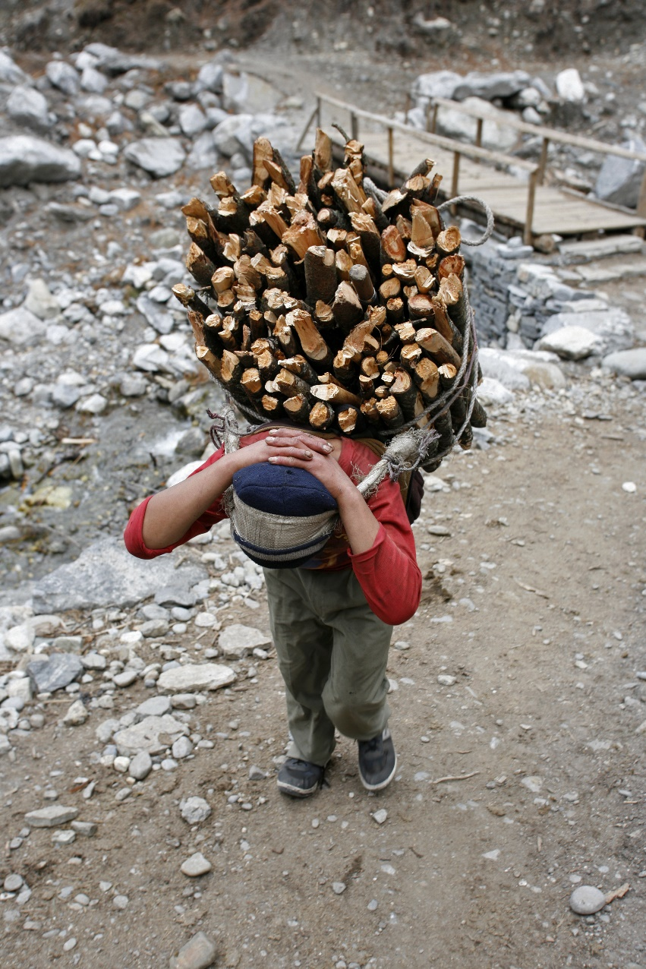
Findings from the Pilot Projects
In all countries children & youth reported that they wanted to continue CFA activities.
Notes:
In all countries children & youth reported that they wanted to continue CFA activities.
Example: In all pilot countries initiatives have been started that will continue to improve child protection at the local level, such as the boy in India who is working with his peers to address child labour in his community.

Slide 9
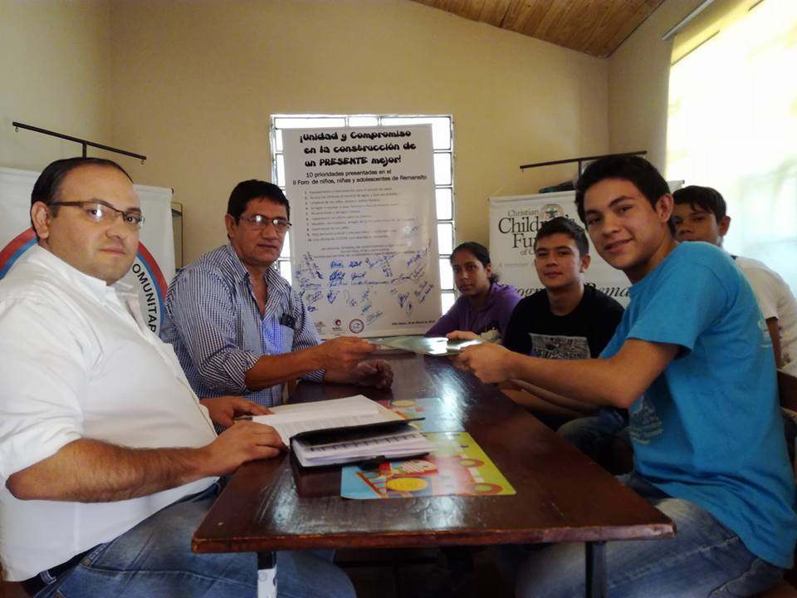
Findings from the Pilot Projects
Adults stakeholders across the pilot countries were, in general, engaged and supportive.
Notes:
Adults stakeholders across the pilot countries were, in general, engaged and supportive.
Examples: Principal in Paraguay who has been pushing 7 other schools to adopt CFA and has requested that the Minister of Education roll-out CFA in all schools in the region

Slide 10

Findings from the Pilot Projects
Within the short timeframe of the pilots, we have seen concrete results.
Notes:
Within the short timeframe of the pilots, we have seen concrete results.
Most importantly, within the short timeframe of the pilots we have seen concrete results.
Examples: Murals and open sessions organized by youth in Paraguay with contact details for child protection mechanism and child protection messages
Example: Commitment from local authorities in India to train teachers in child rights

Slide 11
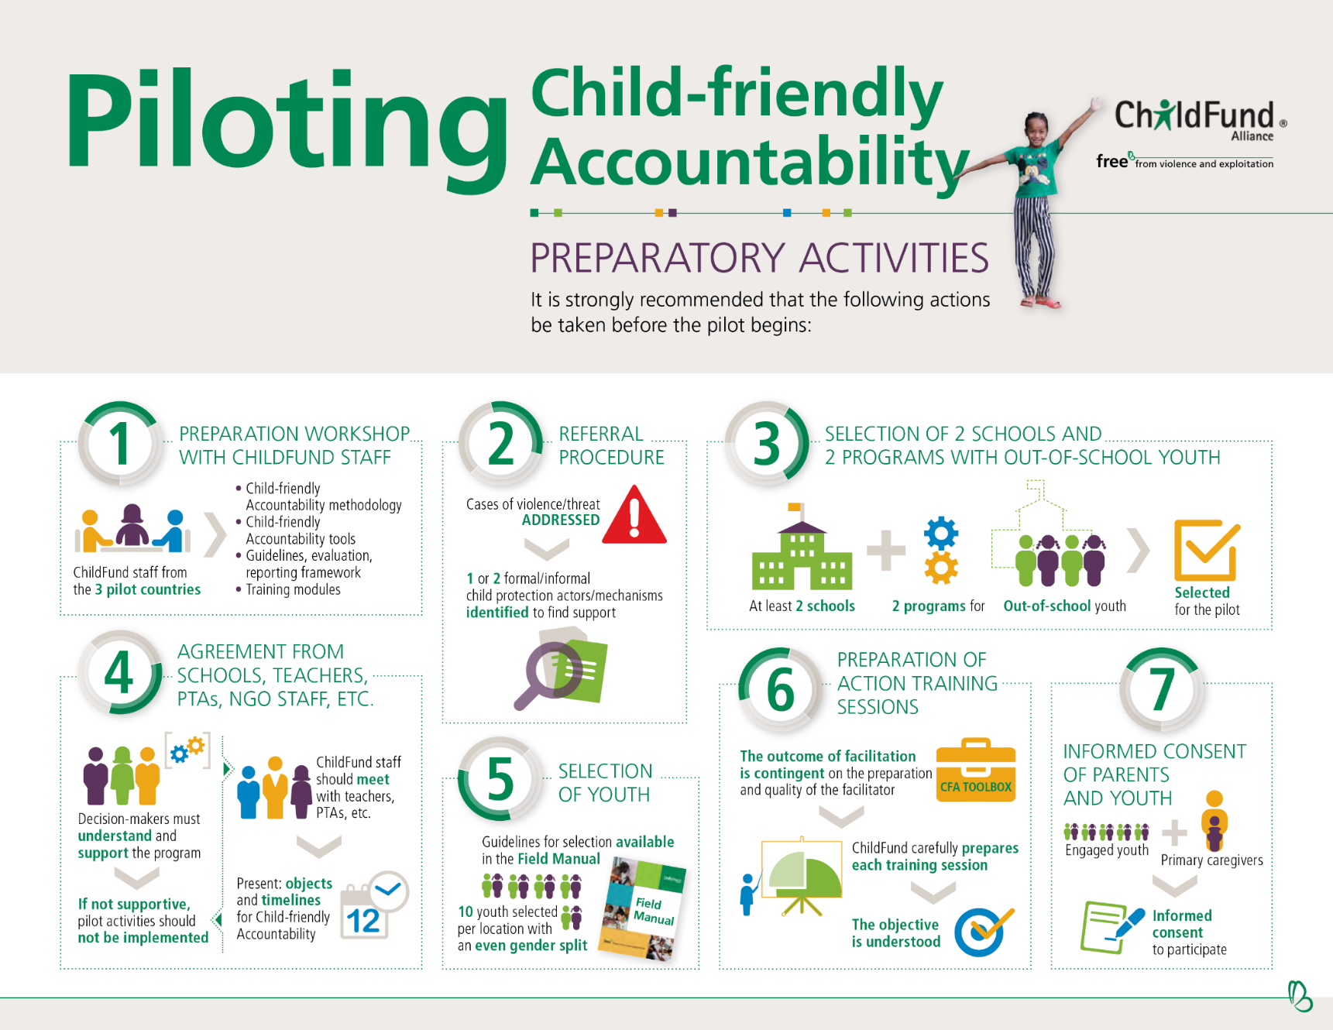
Lessons Learned for Full Implementation
Notes:
The importance of preparatory actions: Preparatory actions must be fully and carefully implemented, particularly (a) the context assessment, (b) putting in place a sound referral network and (c) ensuring that there is adult by-in.

Slide 12

Lessons Learned for Full Implementation
Training and trouble-shooting are essential.
Notes:
That training and trouble-shooting is essential: We are working to ensure that CFA adequately prepares field staff and implementers to ensure that child safeguarding is ensured throughout CFA activities and that children are provided with quality support and information related to child rights and child protection. In a few cases during the pilot phase, important safeguarding steps were not adequately understood by implementers.

Slide 13
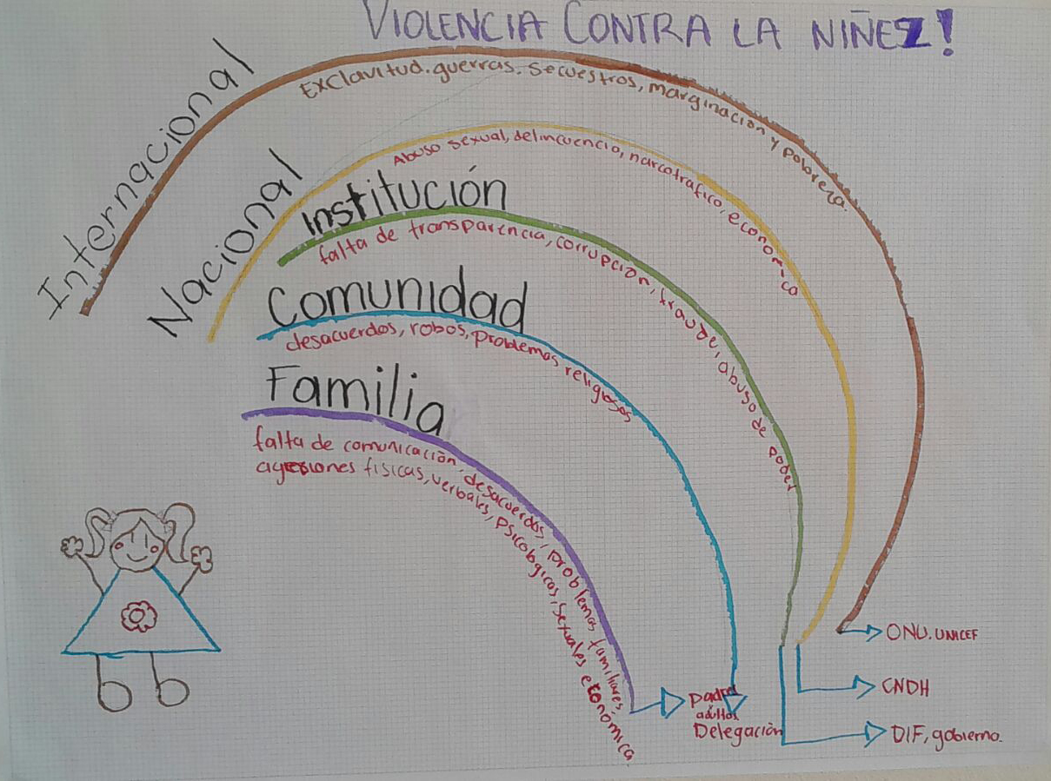
Lessons Learned for Full Implementation
Local adaptation of CFA materials is key.
Notes:
Local adaptation of CFA materials is key: We are looking at how best to encourage and support and enable local adaptation of CFA materials.

Slide 14
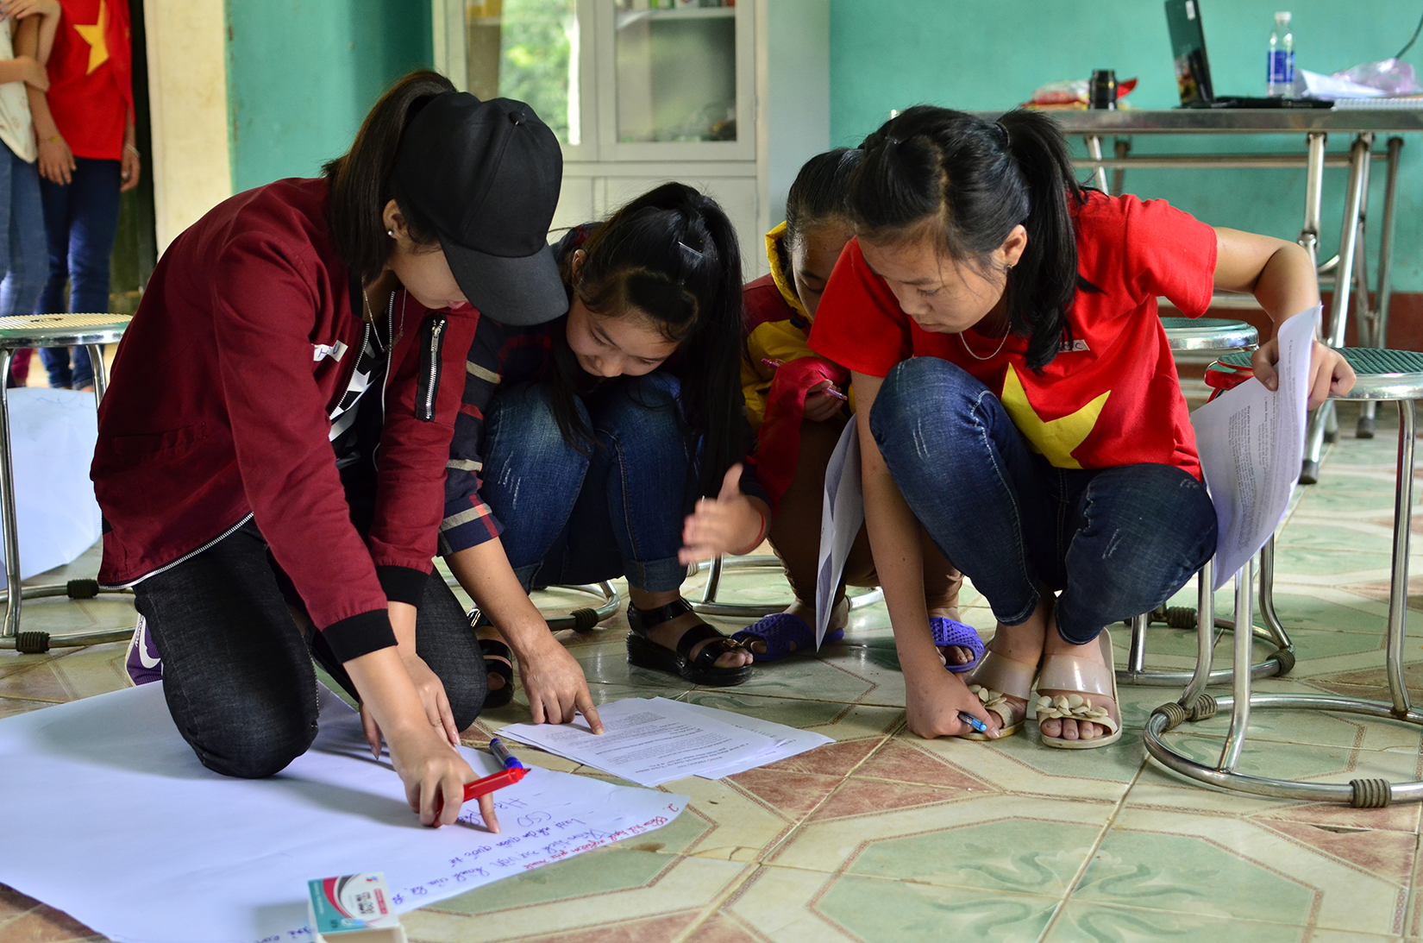
Lessons Learned for Full Implementation
A phased approach is critical.
Notes:
The phased approach is critical: To ensure that children are not overwhelmed by information, it is important that we maintain a phased approach to implementation, starting in a specific setting (e.g. schools) and working on issues directly related to that setting.

Slide 15
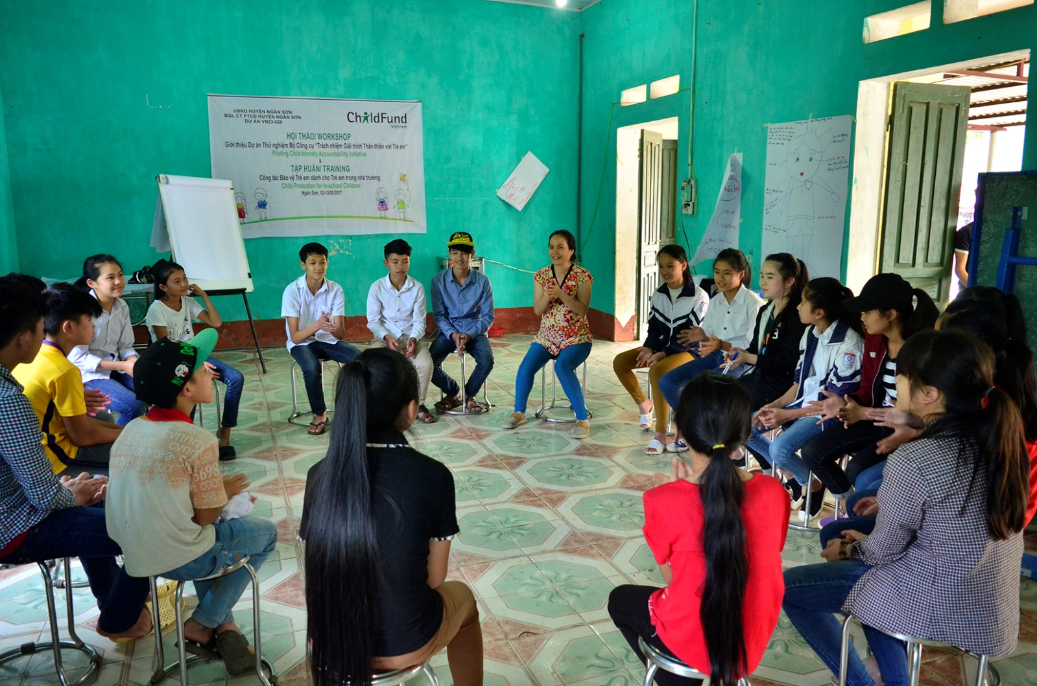
Lessons Learned for Full Implementation
Youth like to have fun!
Notes:
Youth like to have fun! The youth provided us with very useful feedback and information about what activities were enjoyable and engaging and which activities need to be improved.

Slide 16

Global Roll-out
Notes:
Building on the success and lessons-learned from the pilot, we are moving towards global roll out which requires:

Slide 17

Global Roll-out
Revision of the toolbox and field manual and development of training material for implementers and facilitators.
Notes:
Revision of the toolbox and field manual and development of training material for implementers and facilitators (September and October)

Slide 18

Global Roll-out
Development of an ICT tool.
Notes:
Development of an ICT tool to support roll-out (web-based until App can be funded)

Slide 19
Global Roll-out
The following additional countries are expected to implement Child-friendly Accountability in FY2018:
Cambodia
El Salvador
Indonesia
Kiribati
Papua New Guinea (pending confirmation)
Philippines
South Korea (pending confirmation)
Sri Lanka
Uganda
Notes:
Training of Trainers on Preparatory actions organized for first three – five roll-out countries (mid-November)
Training of trainers on Implementation organized for first three – five roll-out countries (mid-December)
Every three months we expect to begin operations in three – five new roll-out countries
Troubleshooting / Child safe-guarding support

Slide 20

Global Roll-out

