Slide 1
SMALL VOICES
BIG DREAMS 2019
OVERVIEW, LEARNINGS
AND RECOMMENDATIONS

Slide 2

Violence against children
as explained by children

Slide 3
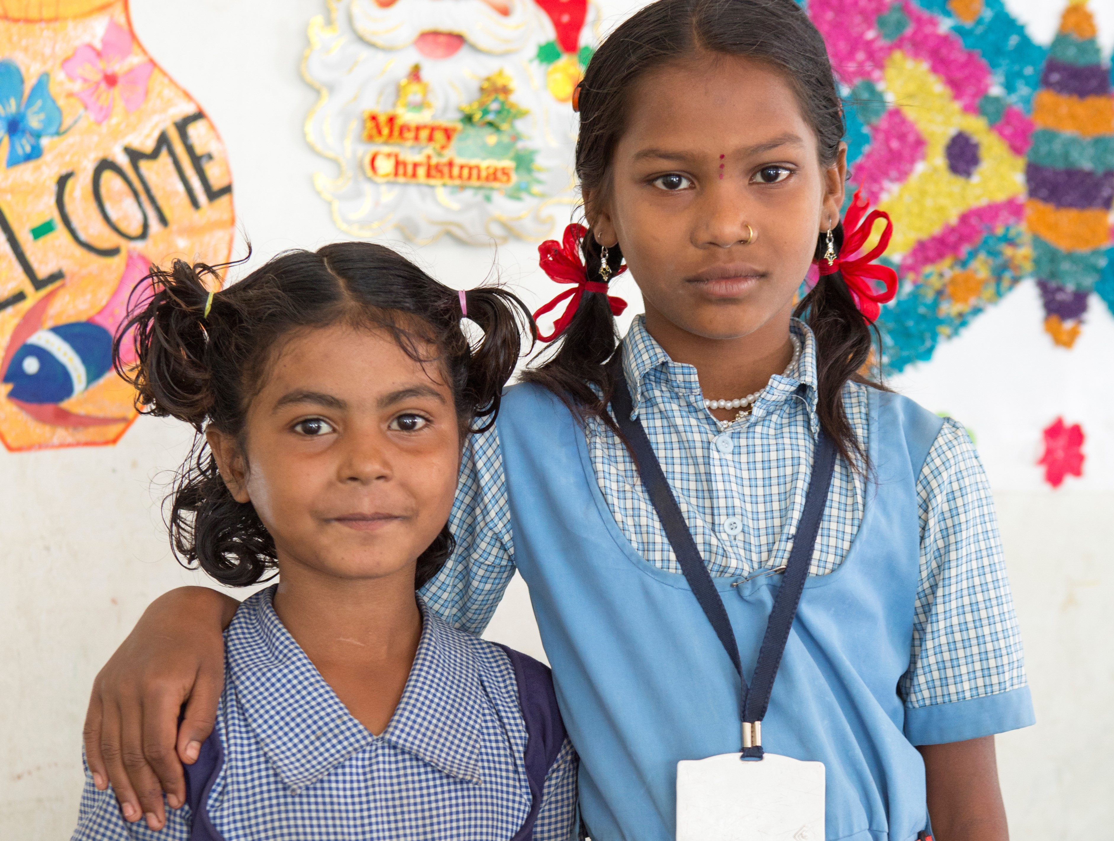
“Society should give a voice to children, so that they feel safe and protected.”
Rimpal, 12, India

Slide 4
SVBD 2019 - AGENDA
Project overview (assessment, background and scope)
Campaign materials
Campaign results
Global Learnings
Recommendations
Appendix (Budget and timeline)

Slide 5
PROJECT OVERVIEW – Assessment
SWOT ANALYSIS SVBD 2016 | SVBD 2019
Need of improving the project methodology (scientific rigor, data selection, sample representation, analysis of data, etc.) | An international team of researchers specialized in child participation projects have created a strong and rigorous research methodology in which children themselves were partially involved
Lack of evidence-based messages may have had consequences for the survey’s media and advocacy impact | This rigorous methodology and data analysis has provided evidence-based messages for stronger media and advocacy impact
Need to join forces and align objectives of the Communication & Marketing Committee (CMC), the Advocacy Task Force (ATF) and the Alliance Program Committee (APC) | Ongoing feedback from the CMC, the Secretariat and occasional peer reviews from the Advocacy Task Force (ATF), and the Alliance Program Committee (APC)
No lead generation opportunities | A quiz was developed (SVBD landing page) in order to generate leads. We obtained a total of 3.714 leads
A tangible public-facing global campaign ask, directly linked to the alliance advocacy strategy was needed | A tangible public-facing global campaign ask was a missing element

Slide 6
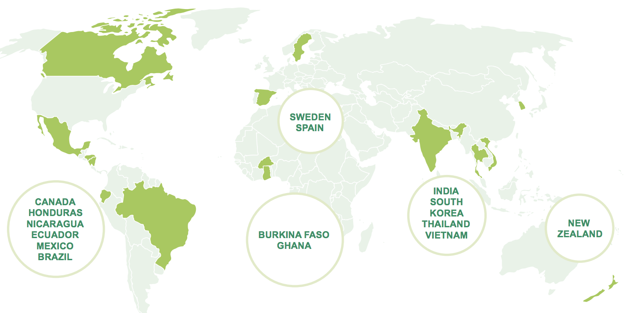
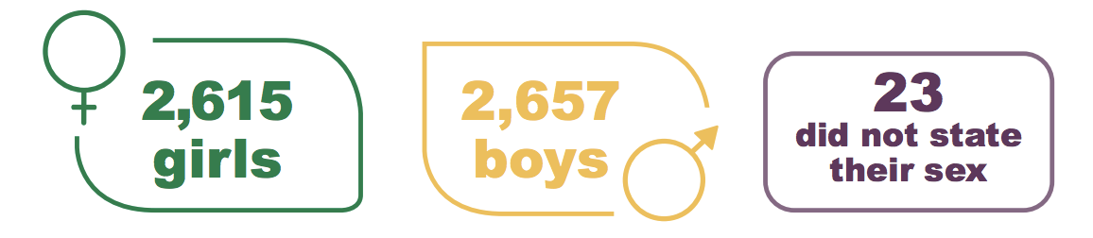
PROJECT OVERVIEW – Background and Scope
Small Voices, Big Dreams 2019 compiles opinions of nearly 5,500 children from 15 countries
Objectives of SVBD 2019
To elevate children’s voices on violence against children
Brand and issue awareness
Lead generation
Theme
The theme for 2019 is Violence against children as explained by children to align with one of ChildFund Alliance’s strategic priorities (Advance Sustainable Development Goal Target 16.2).

Slide 7

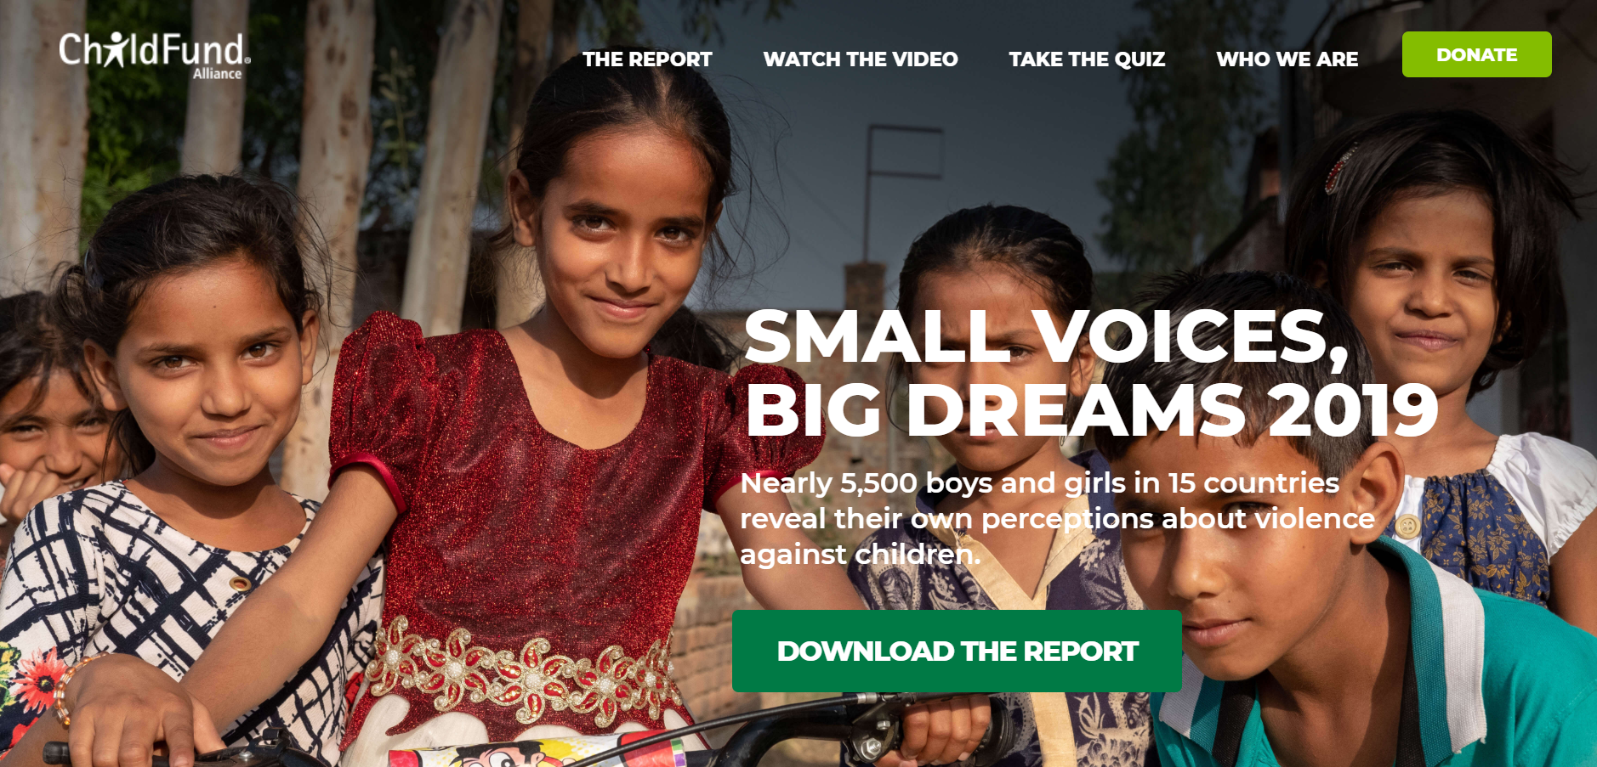

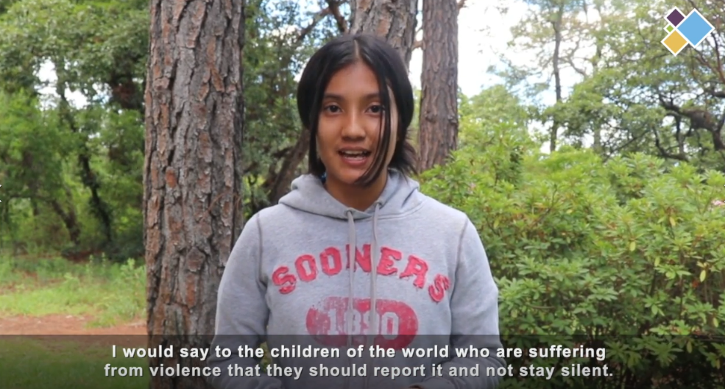

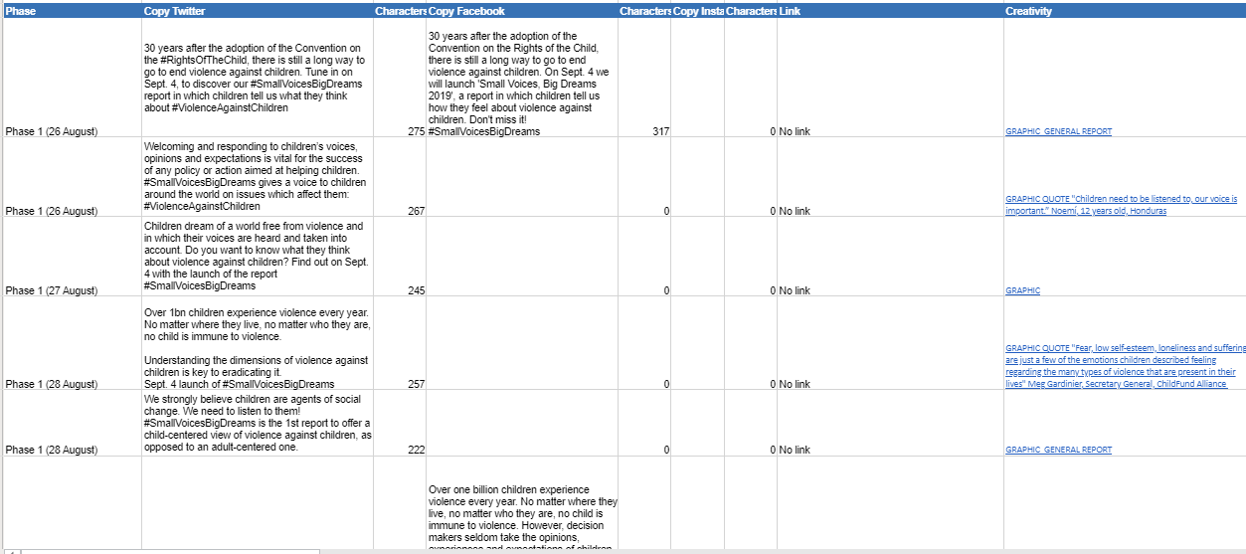
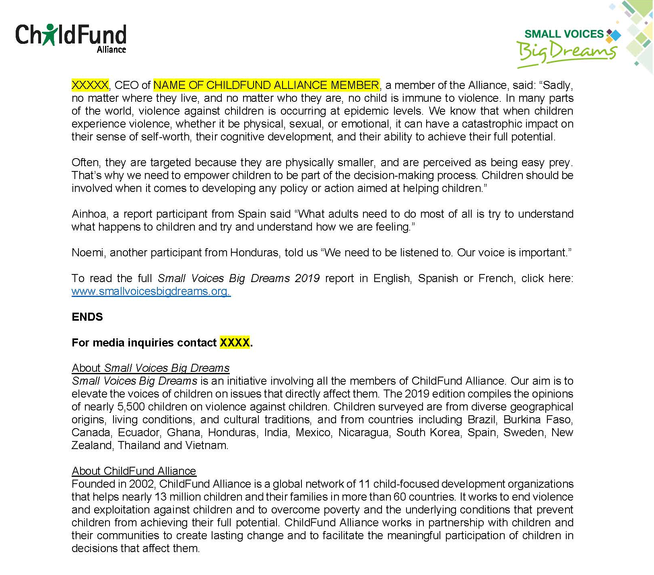
CAMPAIGN MATERIALS
Landing in various languages
Spark for internal Project management
Videos in English, Spanish & French
Report in several languages (English, Spanish, French, Portuguese and Korean)
Press release in several languages
Social media products in various languages

Slide 8
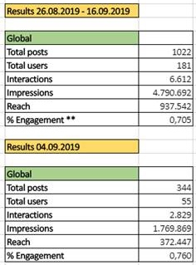
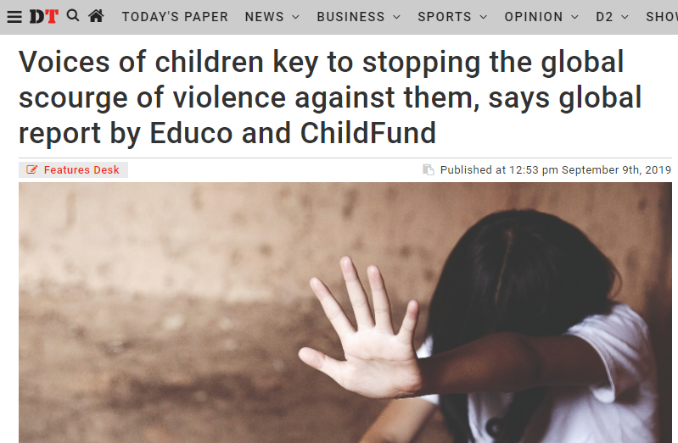
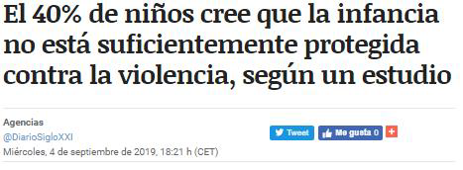
CAMPAIGN RESULTS SNAPSHOT
Media
Over 100 media hits in global and national influential media such as Reuters, EFE, Europa Press, Relief Web, Daily Graphic, ABC, etc.
Social Media
Leads
 | Country | Leads
1 | Bangladesh | 496
2 | Spain | 470
3 | Bolivia | 441
4 | India | 416
5 | Nicaragua | 396
6 | El Salvador | 328
7 | Guatemala | 323
8 | Burkina Faso | 227
9 | Benin | 196
10 | Senegal | 189
11 | Mali | 183
12 | United States | 15

Slide 9
GLOBAL LEARNINGS
1. Key campaign ask was missing
By not having a tangible global public-facing campaign ask it is difficult to engage the public, and therefore meet our objectives of brand awareness and lead generation
2. Complex Project Management and members engagement
Taking into consideration the different members agendas and strategic priorities as well as the different alliance committees' strategies and agendas, it has been challenging to manage the project and ensure a high level of engagement of each member
3. Branding complexity
SVBD has pointed out the complexity of launching a global Alliance initiative in some markets where several members have a presence but do not share branding and the ChildFund name (e.g., India, Guatemala, Burkina Faso, etc.)

Slide 10
RECOMMENDATIONS
Report should be a tool within a broader and coordinated strategy with a key campaign ask: For the next edition, we highly recommend linking the project and subsequent campaign to a ChildFund Alliance (advocacy) strategy that contributes to building the alliance identity. Based on a theory of change and power analysis, the campaign would lead to a public-facing campaign ask, and therefore have potential for much greater impact. To leverage the impact, the campaign would also leverage strategic partnerships based on shared objectives in order to save costs.
Task distribution: For the next edition, we recommend the distribution of tasks among the members (according to their resources and capacities), regardless of the figure of project coordinator, with a clear definition of roles and responsibilities. Strengthening the role and leadership of the Secretariat on this initiative would also be key to success. This would lead to better engagement in the project by ChildFund Alliance members and therefore a more successful campaign.

Slide 11
THANK YOU!
QUESTIONS?

Slide 12
APPENDIX

Slide 13
PROJECT TIMELINE
PROJECT TASK | PHASE | PERIOD | DEADLINE
Fieldwork | IMPLEMENTATION AND FIELDWORK | Oct. 2018 – Feb. 2019
Data analysis | DATA ANALYSIS AND REPORT WRITING | Feb. 2019 – Apr. 2019
First draft of the full technical manual | DATA ANALYSIS AND REPORT WRITING |  | 25th April. 2019
First draft of the report | DATA ANALYSIS AND REPORT WRITING |  | 29th April. 2019
Full Technical Manual finalized | DATA ANALYSIS AND REPORT WRITING |  | 15th May. 2019
Report finalized | DATA ANALYSIS AND REPORT WRITING |  | 22nd May. 2019
Translation period | DATA ANALYSIS AND REPORT WRITING | June 2019
Report sent to CFA for validation | LAUNCH OF SVBD 2019 REPORT | 14th-20th June 2019 | 20th June. 2019
Report final copy (Eng, Sp, Fr) | LAUNCH OF SVBD 2019 REPORT |  | 20th Aug. 2019
Media and social media package and report sent to CFA members for pitching under embargo, distribution planning and translation | LAUNCH OF SVBD 2019 REPORT |  | 20th Aug. 2019
Lead generation package sent to CFA members | LEAD GENERATION & SOCIAL MEDIA PLAN | Mid-May 2019 | 23rd – 28th Aug. 2019
UN HLPF – Review of SDG target 16.2 | LEAD GENERATION & SOCIAL MEDIA PLAN |  | 16th July 2019
SVBD Report release | LAUNCH OF SVBD 2019 REPORT | September 2019 | 4th September
SDG Summit | LEAD GENERATION & SOCIAL MEDIA PLAN |  | 24th-25th Sept.2019

Slide 14
PROJECT TIMELINE
This year, ChildFund Alliance has contributed $59,400 USD from member organizations (see Distribution table) + $38,000 USD from ChildFund Alliance budget. Total: $97.400/€86.686
The total expense was €93.304,96 /$103.683,2.
The additional budget paid by Educo was €6.618,96 / $7,352.51 in addition to a junior project manager working full time on the research

Slide 15
International Fundraising Leadership Group on Child Sponsorship
IFL Child Sponsorship group consists of: World Vision, Plan, Save the Children, SOS Children's Villages, Action Aid, ChildFund
The concept floated by the chair, to identify common ground where all international child sponsorship organizations could collaborate, to strengthen child sponsorship.
Three organizations have already conducted research into their programs: Compassion, World Vision and Plan. Save the Children is planning to in the next year.
ChildFund Alliance, ActionAid and SOS will be able to add their own findings to this research – once the parameters are determined.
Notes:
The group is chaired by Save the Children and Plan. Previous chair was world Vision
Meeting discussed a range of issues including the dataset included in your appendix.

Slide 16
International Fundraising Leadership Group on Child Sponsorship
The outcomes of the research project, will determine if joint marketing campaign is possible.
Potential objectives:
  Improve awareness and trust in child sponsorship as an effective concept to tangibly impact children’s lives, and the collaboration and partnership between the larger international brands behind it.
  Drive renewed category relevance and revenue growth.
Potential opportunity:
  To campaign together as a coalition to end/challenge ending a global issue affecting children, through which sponsoring a child is a great solution.
Initial reaction
  Enthusiasm around collaboration on the research component of the project. All organisations are engaged including Compassion.
  The Communications and Marketing Committee (CMC): Concern the ChildFund Alliance would be crowded out in a joint marketing campaign. However, we would like to stay engaged.
Next steps
  Research group to meet 9th January. Compassion is also included.
  Alliance Program Committee (APC) co-chair is aware and will engage in the call on 9th January.
  Communication and Marketing Committee co-chairs will stay engaged and update the committee as needed.

Slide 17
Appendix: Global Child Sponsorship Data
The following are slides are from global data compiled by World Vision International on child sponsorship revenue from:
  ChildFund Alliance
  ActionAid
  SOS Children's Villages
  Save the Children
  Compassion
  Plan
  Note: Data has been collected and compiled by World Vision International without inputs from the organizations, some Childfund Alliance members are missing from some of the data sets.

Slide 18
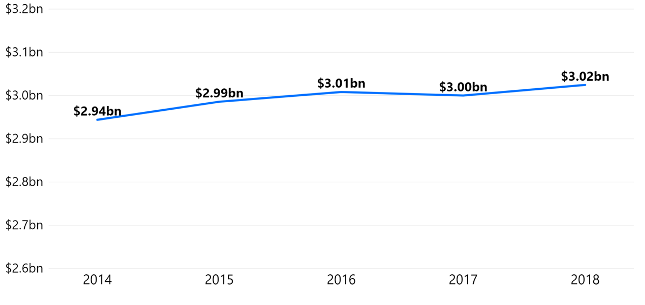
Appendix: Global Child Sponsorship Revenue
Note: Data collected and compiled by World Vision International without inputs from the organizations.

Slide 19
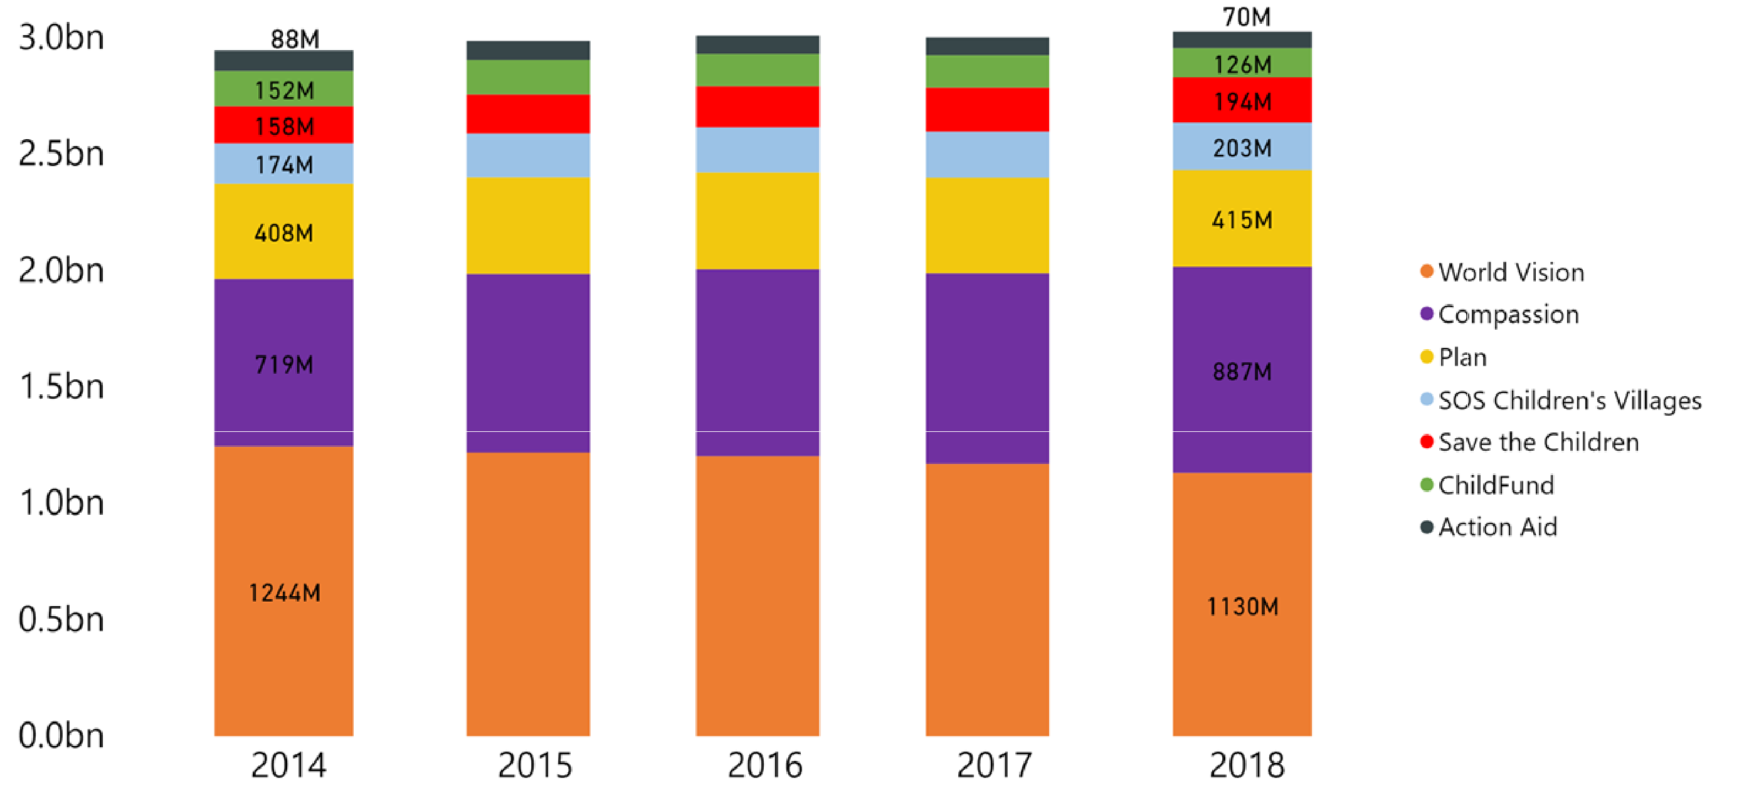
Appendix: Global Child Sponsorship Revenue by NGO
Note: Data collected and compiled by World Vision International without inputs from the organizations.

Slide 20
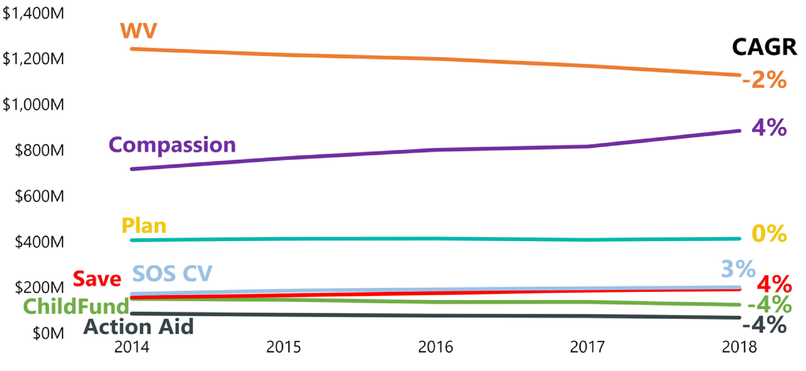
Appendix: Global Child Sponsorship Revenue and CAGR
Note: Data collected and compiled by World Vision International without inputs from the organizations.

Slide 21
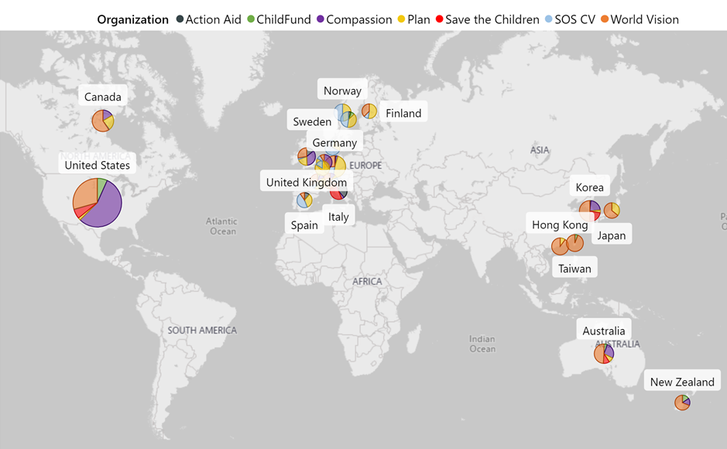
Appendix: Sponsorship Revenue by Country
Note: Data collected and compiled by World Vision International without inputs from the organizations. Markets selected are World Visons top 20. Missing ChildFund Alliance data from Canada and Spain

Slide 22
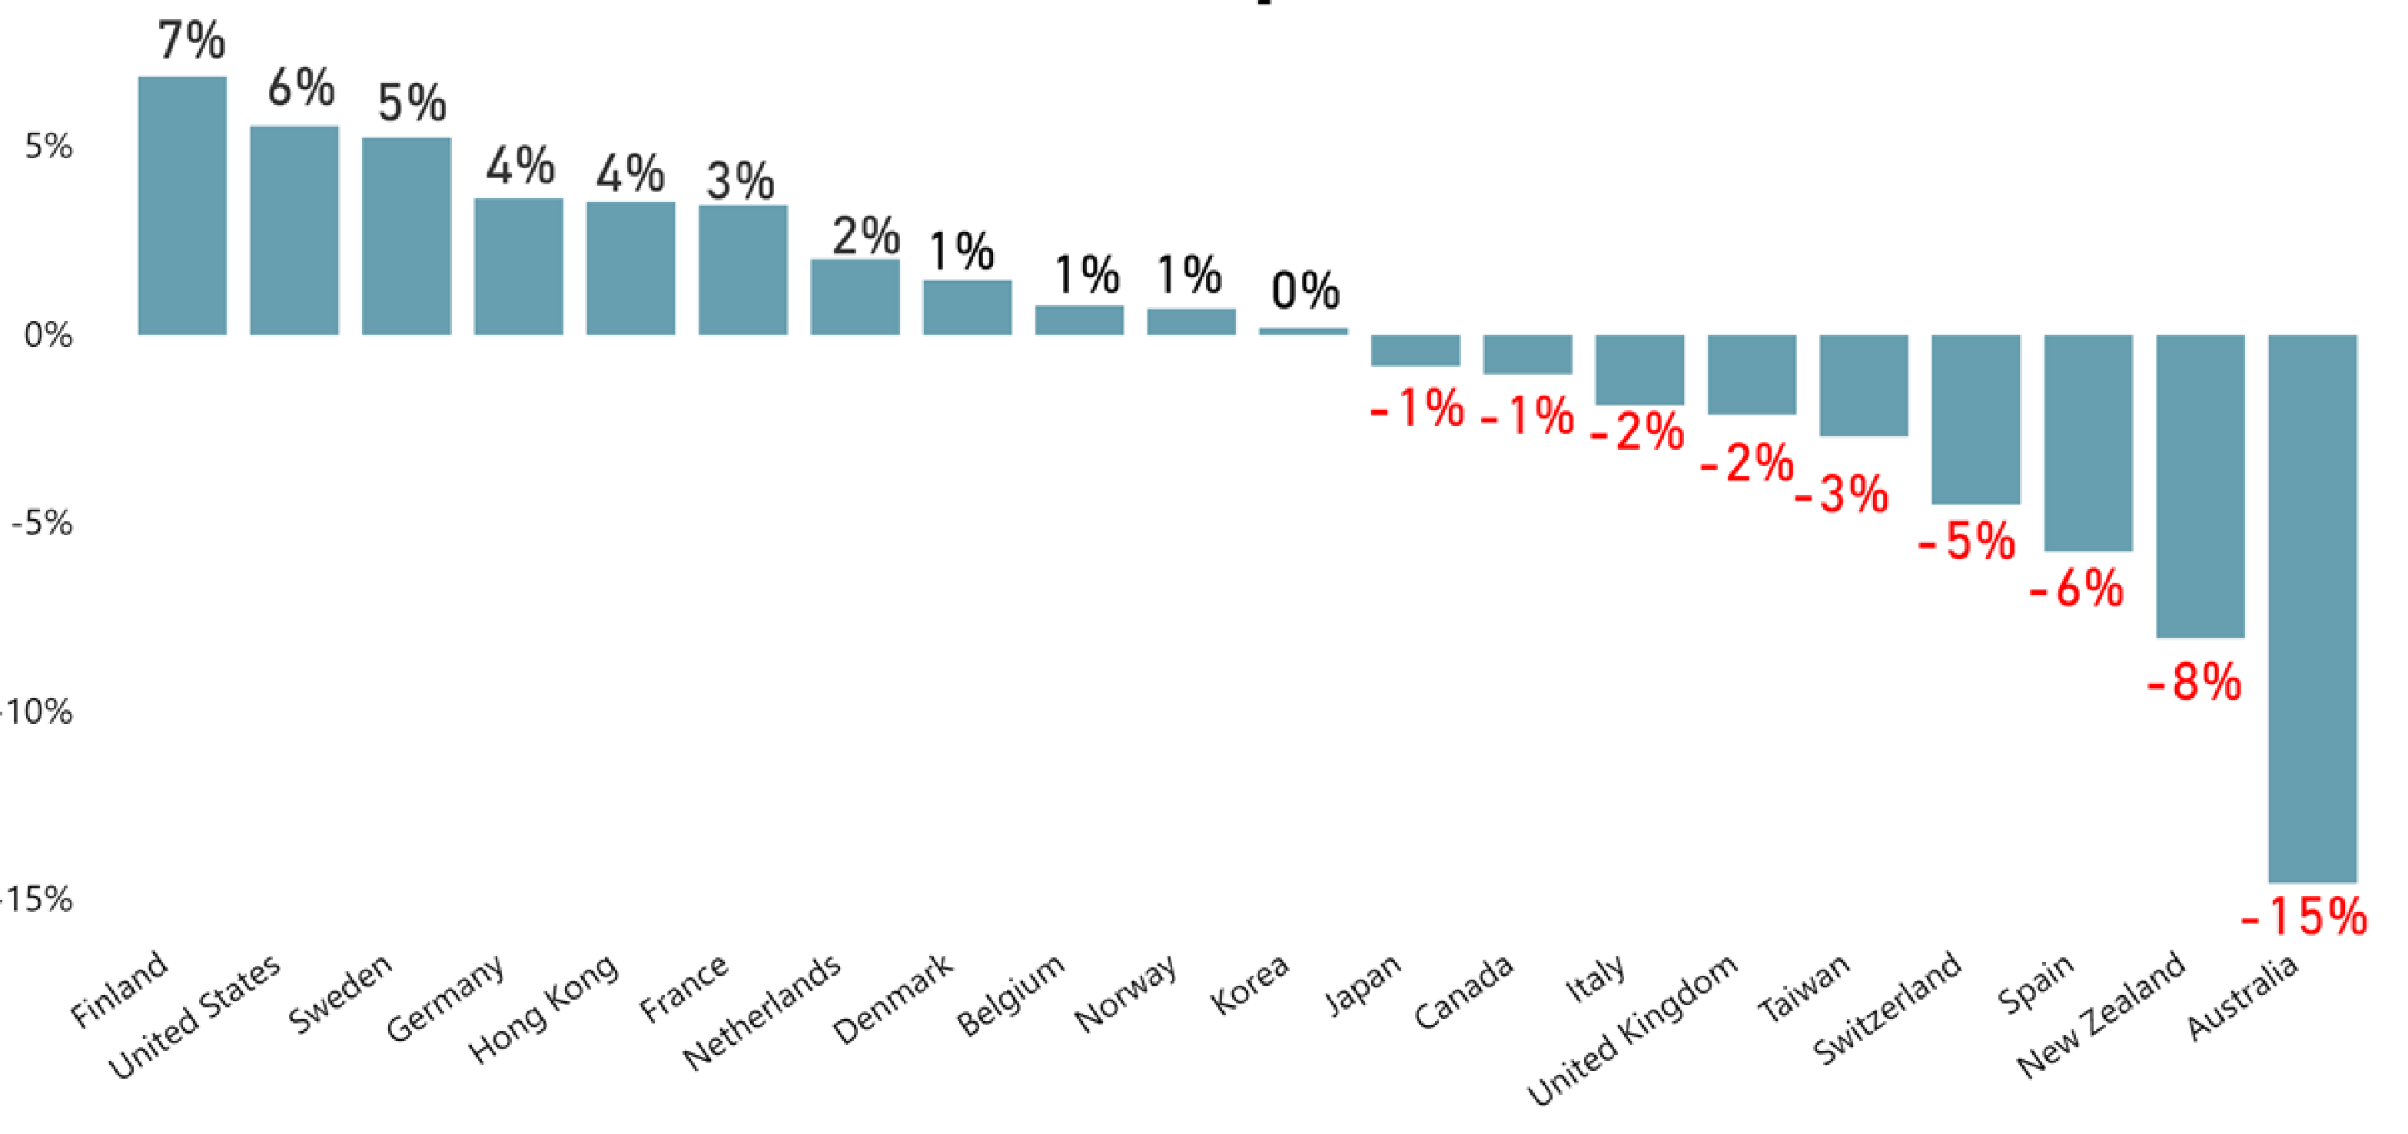
Appendix: Global Child Sponsorship YoY Growth FY17-FY18

