Slide 1
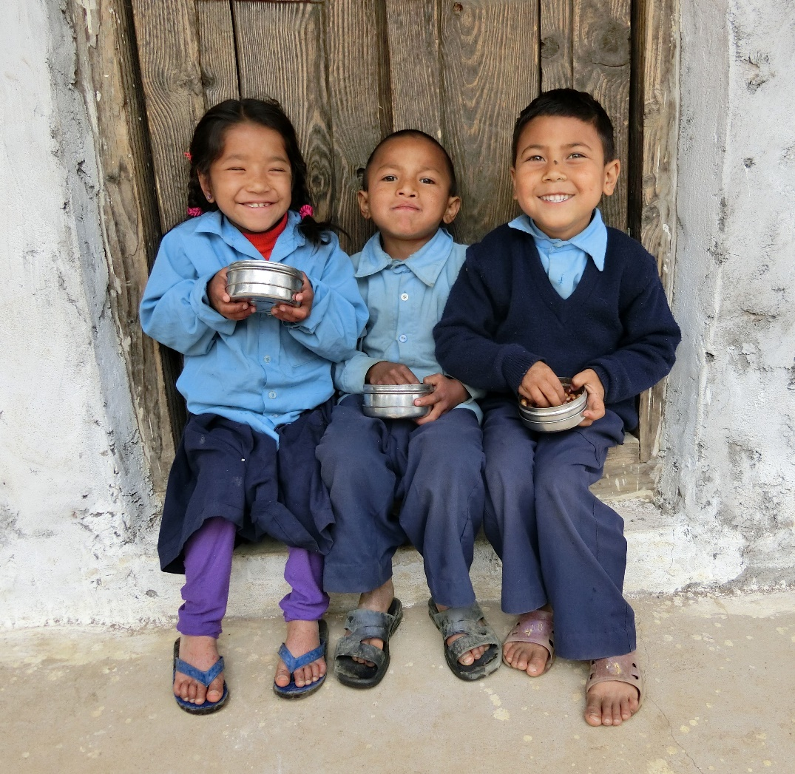
^{APC}
Report to
CEO Forum
Nov 2017
Area of Programme Committee

Slide 2
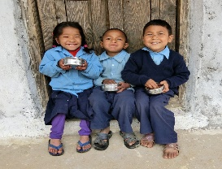
    Actions/Progress 2016-2017
Provided inputs to the consolidated data on members’ work.
Continue sharing information and raising issues re Program Standards most recently Child Safe Guarding.
Many members contributed to the Child Friendly Accountabilities pilot
Identified and implemented joint initiatives of multiple members for EVAC, such as School Based Violence Prevention pilot.
Shared field staff training opportunities (i.e. Trainers’ training for Community Based Child Protection Mechanisms).

Slide 3
    APC: Opportunities
APC is the core CF Alliance group best situated to provide practical implementation advice about program and key sector approaches (i.e. human rights based approach, gender equality approach)
Opportunities for starting collaborative program learning initiatives (i.e. pilot projects, staff training)
Opportunity for exploring joint program grants submissions
Opportunities for sharing good practices (i.e. sharing programme policies and approaches)
Opportunities for providing a more global perspective on the program area which is not covered by specific thematic task forces (Education, adolescent development,

Slide 4
    Actions: next steps
Strategic Priority One
New co-chairs: Australia, Ireland, Japan
Proposal the APC be maintained/re-instated an important mechanism for the Alliance members.
Recommendation that APC be subsumed within the Child Friendly Accountabilities Task Force
Concern that we may losing opportunities for sharing further exploring program effectiveness
Face to face meeting proposed 2018 Vietnam
Suggested Agenda items:
    Program standards learning and sharing
    Joint implementation and coordination among implementing and non-implementing members
    Strategic Collaboration opportunities: Replicating interventions and grant proposals
    Definition of terminologies around program areas to enhance consolidated data and demonstrate our evidence in a more aligned way
    Mainstreaming DRR into development programs
    Ensuring EVAC has a program home at CO level

Slide 5
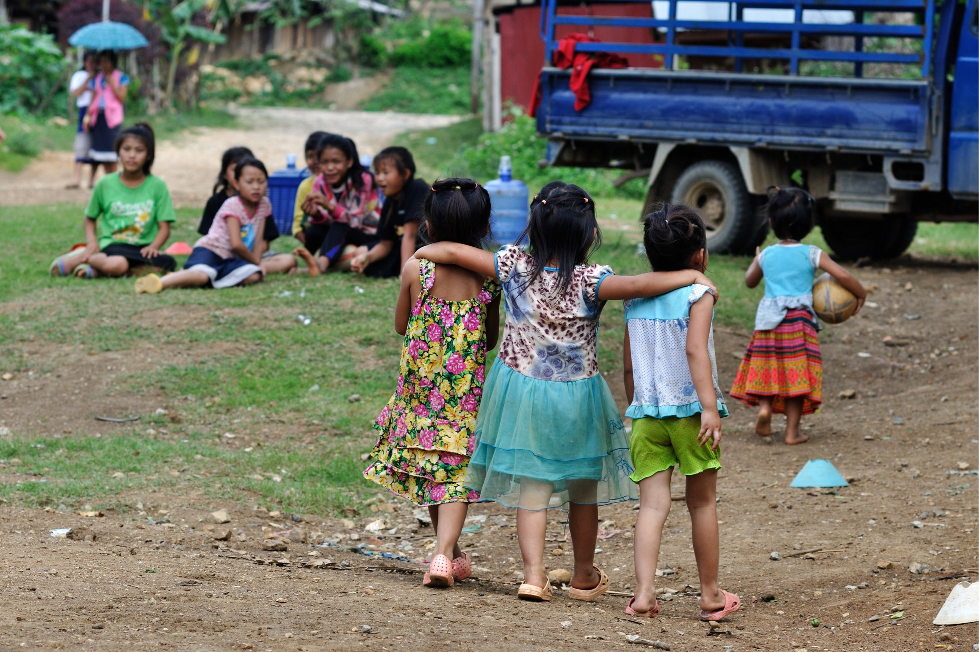
The End

