Slide 1
Telemarketing:
Managing outsourced and in-house TM programs for donor development

Slide 2
4 strategies for Educo:
Emailing
Direct mail
Ecommerce
But above all, representing more than 80% of the revenues and the highest ROI by far:
Telemarketing

Slide 3
Cold call: new donors acquisition
Welcome call: reception & info
Loyalty: engagement
Upgrade: billing increase
Unpaid fees: recovering unpaid months and avoiding lapsed donors
Recovery of lapsed donors

Slide 4
UPGRADES

Slide 5
UPGRADES
STRATEGY AND MAIN CAMPAIGNS:
STRATEGY:
REGULAR DONORS
Increase fee
Sponsors to also colaborate with lunchroom grants and viceversa (cross selling)
Push for single gifts in summer and Xmas
SINGLE GIFT DONORS
Convert to regular donors
Push single gifts at different times during the year
MAIN CAMPAIGNS:
NEW TAX LAW
SUMMER LUNCHROOM GRANTS
GIFT CATALOGUE

Slide 6
NEW TAX LAW

Slide 7
NEW TAX LAW
Since 2014 we’re getting the benefits from a new tax law favorable to gifts.
Telemarketing campaign (external call center).
From March to June (+/- corresponding to the period people submit their yearly income statement), we start calling our regular donors to inform them about the new law that can benefit them in their income statement
Our “sales pitch” consists in:
Informing/reminding of the new tax law
Suggesting to increase their fee since that won’t suppose a net incremental economical effort for them: “until 2014 you could deduct up to 25% of your gifts from your income statement but now you can deduct up to 75%. That’s why we’re suggesting to our sponsors an upgrade of their monthly fee of 3,75€, which corresponds to the difference they can deduct on a yearly base”.
Linking the amount suggested to a tangible product or benefit for the children or their community (example: 3€/month = a pig for a family in Guatemala )
TELEMARKETING

Slide 8
NEW TAX LAW:
Telemarketing campaign (external call center)
TM UPGRADES | Contacts | Upgrades | Conversion | Monthly avge upgrade | Annualized incremental income | Cost | ROI
2013 | - | - | - | - | - | - | -
2014 | 58.263 | 15.486 | 27% | 3,8 € | 698.728 € | 212.125 € | 2,3
2015 | 58.212 | 21.520 | 37% | 3,6 € | 924.499 € | 218.358 € | 3,2
2016 | 62.020 | 15.267 | 25% | 3,8 € | 701.671 € | 190.088 € | 2,7
TOTAL | 178.495 | 52.273 | 29% | 3,7 € | 2.324.899 € | 620.571 € | 2,7
TELEMARKETING

Slide 9
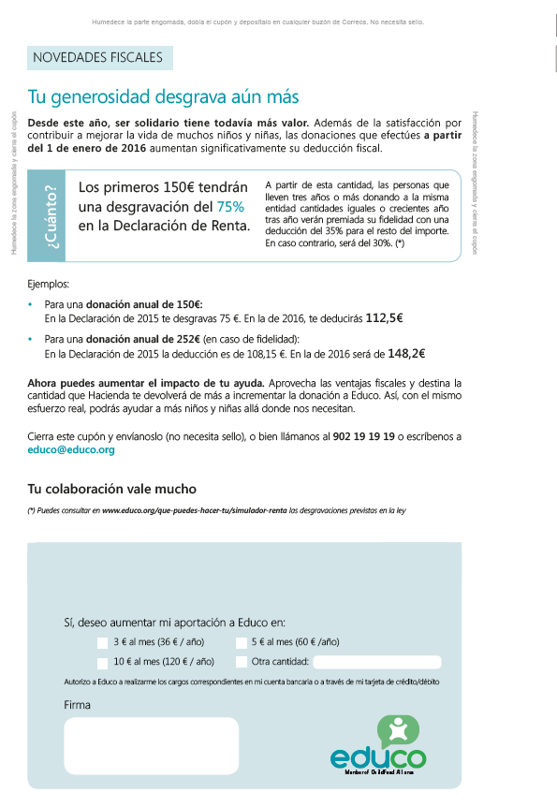
NEW TAX LAW
Direct mail campaign: we send the tax certificate together with a pre filled form explaining the benefits of the new law
TM UPGRADES | Mails | Upgrades | Conversion | Monthly avge upgrade | Annualized incremental income | Cost | ROI
2015 | 100.256 | 703 | 0,7% | 4,9 € | 41.336 € | 4.512 € | 8
2016 | 99.100 | 324 | 0,3% | 5,6 € | 21.773 € | 2.000 € | 10
DIRECT MAIL

Slide 10
NEW TAX LAW:
Emailing campaign:
06/05/2016: emailing sent to 58,000 leads and donors with subject “Do not pay taxes”
Landing page tax reduction simulator
Only 3 new gifts
24/12/2016: emailing sent to 60,000 leads with subject “Maximize your tax deduction”.
→ Landing page ecommerce (gift catalogue)
10 new donors with revenues of 2.905€ on a 12 months base
EMAILINGS

Slide 11
SUMMER LUNCHROOM GRANTS PROGRAM

Slide 12
UPGRADES
SUMMER LUNCHROOM GRANTS:
Telemarketing campaign (external call center).
From May to July, we call our single gift donors for our summer lunchroom grants program
Our “sales pitch” consists in:
Informing about the at risk situation that represents the summer for children from vulnerable families in Spain: “School is ending and the holidays will leave thousands of children without their only daily healthy meal”
Insisting on the proximity of the issue and its emergency
Giving a solution: Educo’ summer lunchroom grants
Linking the amount suggested to a clear benefit for the children (example: with 25€/month you guarantee 2 weeks of lunchroom. With 130€ you can finance a full summer lunchroom grant)
TELEMARKETING

Slide 13
SUMMER LUNCHROOM GRANTS:
SUMMER LUNCHROOM | Contacts | New gifts | Conversion | Gifts average | Income | Costs | ROI
2014 | 7.315 | 1.198 | 16% | 78 € | 93.684 € | 25.603 € | 2,7
2015 | 8.921 | 1.358 | 15% | 73 € | 99.120 € | 31.224 € | 2.2
2016 | 12.817 | 2.411 | 19% | 65 € | 156.040 € | 44.860 € | 2,5
TOTAL | 29.053 | 4.967 | 17% | 70 € | 348.844 € | 101.686 € | 2,4
TELEMARKETING

Slide 14
UPGRADES
SUMMER LUNCHROOM GRANTS:
Emailing campaign:
08/06/2016: emailing sent to 90,000 leads, sponsors and donors with subject “(name), children also eat during summer”
Landing page to form of lunchroom grants.
181 new gifts (26 regular donors + 155 single gifts) with revenues of 27,000€ on a 12 months basis (results 2015: 48,000€)
EMAILINGS

Slide 15
GIFT CATALOGUE

Slide 16
UPGRADES
GIFT CATALOGUE:
Telemarketing campaign (external call center).
From November to 1st week of January, we call our active donors (regular donors and single gift donors of the last 12 months)
Our “sales pitch” consists in:
Taking advantage of Xmas period and to suggest to also offer children and families some presents
Those presents are real gifts for real needs
We mention different gifts of different kinds for different countries, with a wide range of prices From books to cleaning sets… Some examples:
A book for 6€
Diapers for orphan children for 12€
A corn bag for 28€
Tell me which amount you’d like to offer and I’ll tell you the gifts available for this amount

Slide 17
UPGRADES
GIFT CATALOGUE:
2015: 1st gift catalogue with almost 600K€ revenues.
2016: 682.452€ total revenues, corresponding to 29.518 gifts with an average of 23,1€.
Most of the revenues come from the telemarketing campaign (80% = 545K€)
TELEMARKETING

Slide 18
GIFT CATALOGUE:
DONATIVOS / CATALOGO | Contacts | New gifts | Conversion | Gifts average | Income | Costs | ROI
2015 | 44.138 | 24.279 | 55% | 20 € | 484.123 € | 154.483 € | 2,1
2016 | 46.432 | 25.968 | 56% | 21 € | 545.847 € | 162.512 € | 2,4
TOTAL | 90.570 | 50.247 | 55% | 20 € | 1.029.971 € | 316.995 € | 2,2
TELEMARKETING
With only 5% more contacts, we managed a +13% revenues thanks to a better conversion and avge gift.

Slide 19
UPGRADES
GIFT CATALOGUE:
Gift catalogue sent to 62.867 donors and sponsors with pre filled form
957 answers with an average gift of 42€ for a total revenues of 40,663€
ROI: 0,3
Insert in top newspaper in Catalunya: 134.000
DIRECT MAIL

Slide 20
UPGRADES
GIFT CATALOGUE:
Ecommerce Educo launched on July 2016, with all the advantages of the ecommerce model:
Buying various products in the same process
Suggesting products before finalizing the buying process to increase the basket
Round up of the gift
Possibility of Paypal payment
Possibility of promo code
More conversion, and more products per purchase in 2016 (from 1,07 to 1,3)
ECOMMERCE

Slide 21
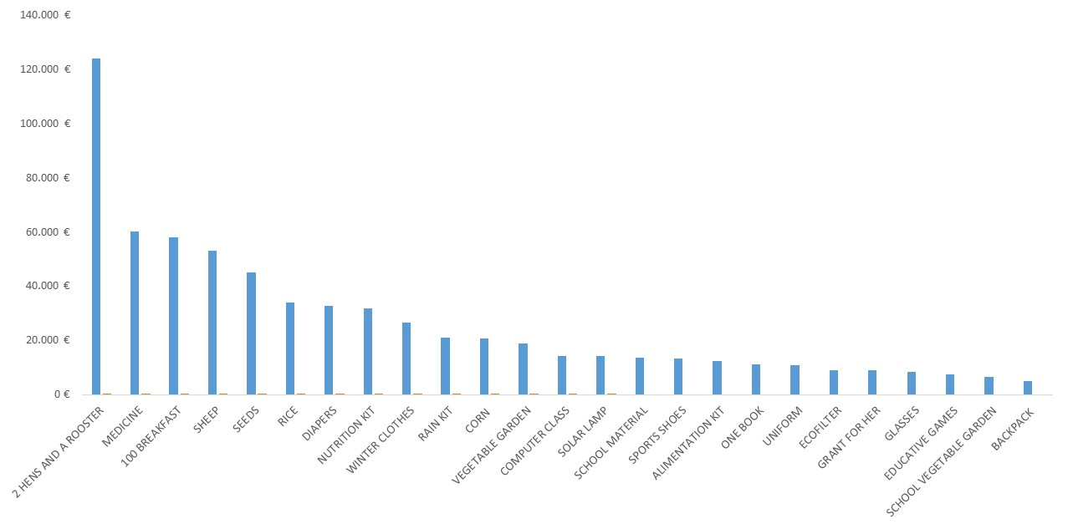
UPGRADES
GIFT CATALOGUE: TOTAL RESULTS
Top 25 products in terms of revenues.
Top 1 with difference: 2 hens and a rooster: 4,650 for 124K€
Total cost: 163K€
ROI: 0,7

Slide 22
UNPAID FEES

Slide 23
UNPAID FEES:
Objective: recover unpaid fees and avoid lapsed donors
Recovering of first return receipts is automatized: the bill is resent automatically up to 4 times
If the payment does not occur, we start calling asking if there were some kind of issue with the payment (for instance the visa might have expired). We’ll try contacting with the donor during 3 months.
We propose different solutions:
Resend the receipt
Split the debt in different payments
Change method of payment
Cancel the debt but continue with following receipts
Suggest other type of gift
Downgrade the monthly fee
After 3 months if we have not managed to contact with the donor we send him a letter communicating about the ending of the collaboration. Always thanking the donor for his generosity.
We classify the lapsed donors in different categories for future reactivating campaigns

Slide 24
UNPAID FEES
Unpaids | Contacts | Retentions | Conversion | Retention avge | Annualized income
2013 | 8.626 | 2.199 | 25% | 25 € | 662.088 €
2014 | 6.130 | 1.754 | 29% | 34 € | 724.980 €
2015 | 6.729 | 1.406 | 21% | 32 € | 539.544 €
2016 | 6.712 | 3.317 | 49% | 30 € | 1.194.120 €
TOTAL | 28.197 | 8.676 | 31% | 30 € | 3.120.732 €
In-house call center gives better results than external because of a more personalized treatment
TELEMARKETING

Slide 25
RECOVERING LAPSED DONORS

Slide 26
LAPSED DONORS:
Objective: recover lapsed donors
The database is split in 2 segments:
Lapsed donors of the last 6 to 18 months (6%) 16.000 aprox
Lapsed donors of the last 19 months to 15 years (94%) 250.000 aprox
We hit the database with one or another reactivating campaign according to the classification (reason for ending the collaboration, profile…)
As it represents a large amount of contacts we use external teams
We hit every contact once a year, but the volume is such that it’s an “always on campaign”
In the last 3 years, we managed to recover more than 16,500 lapsed donors, representing a conversion rate of 4,5%.
The average monthly fee is of 18€, higher than main other new acquisition campaigns
Once back a sponsor/donor, the circle starts again…

Slide 27
LAPSED DONORS:
LAPSED DONORS RECOVERY | Contacts | Regular donors | Conversion | Monthly average | Annualized income | Costs | Roi
2013 | 29.036 | 1.452 | 5,00% | 17 € | 299.344 € | 101.626 € | 1,9
2014 | 114.211 | 4.800 | 4,20% | 19 € | 1.081.728 € | 399.739 € | 1,7
2015 | 133.102 | 5.030 | 3,80% | 18 € | 1.076.822 € | 465.857 € | 1,3
2016 | 94.704 | 5.257 | 5,60% | 16 € | 1.029.531 € | 331.464 € | 2,1
TOTAL | 371.053 | 16.539 | 4,50% | 18 € | 3.487.426 € | 1.298.686 € | 1,7
TELEMARKETING

Slide 28
LEARNINGS

Slide 29
 | TIMINGS | REGULAR DONORS | SINGLE GIFT DONORS | REVENUES 2016
NEW TAX LAW | March-June | X |  | 701.671
SUMMER LUNCH GRANTS | May-July |  | X | 156.040
GIFT CATALOGUE | Nov-January | X | X | 545.847
UNPAID FEES | All year round | X | X | 1.194.120
RECOVERY OF LAPSED DONORS | All year round | X |  | 1.029.531
3.627.209
External Call center (+/- 30.000 contacts/month)
In house Call center (+/- 3.000 contacts/month)

Slide 30
Do not hesitate to call your sponsors/donors and ask
Find different times of the year with good arguments
Give tangible examples for different amounts
Engage conversation with the donor and empathize
Be very educated and friendly
Speak their own language

Slide 31
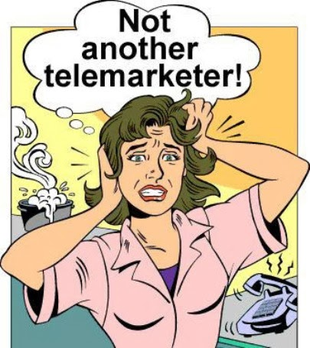

Slide 32
“I don't know the rules of grammar. If you're trying to persuade people to do something, or buy something, it seems to me you should use their language.” David Ogilvy
David Ogilvy is one of the most famous names in advertising and one of the few thinkers who forged this business after the twenties.

