Slide 1

Sponsors Engagement- Skype calls
Communication and Marketing Committee Meeting
ChildFund Alliance
Lusaka, Zambia / March 2017
Marco Hernández – Fundraising & Marketing Manager

Slide 2

Sponsors Engagement- Skype calls
Started in 2014.
Scheduled last Friday of each month.
Avoid children missing school, also they can be scheduled any afternoon after school.
Invitation by mailing / Bulletins.
Sponsor has to pay to cover the transportation fee for his/her sponsored child and caregiver from their home to the LP and back - a DF for the project should be processed.
Specific “video call policy” must be read and signed.
Notes:
Today I’d like to talk about how we arrived at this strategy – our process; reiterate our beliefs, vision, mission and core outcomes; talk about a changing world – some of the trends we see that shaped our strategy; our destination 2020 and our strategy to reach it; and our Balanced Scorecard, the tool we will use to help us stay on track to reach our destination.

Slide 3
Sponsors Engagement- Skype calls
The conversation is held through generic accounts to reduce risks for both parties.
We ask the sponsor to be online 10 minutes before.
The child has to come with his/her caregiver and somebody from the LP has to be present at all time with them.
Finally, the normal length of a video-call is about 15 minutes.
Notes:
Today I’d like to talk about how we arrived at this strategy – our process; reiterate our beliefs, vision, mission and core outcomes; talk about a changing world – some of the trends we see that shaped our strategy; our destination 2020 and our strategy to reach it; and our Balanced Scorecard, the tool we will use to help us stay on track to reach our destination.

Slide 4
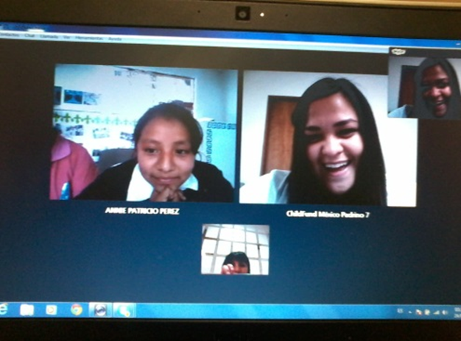
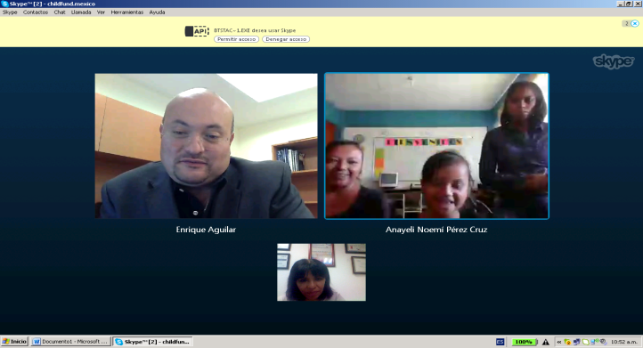
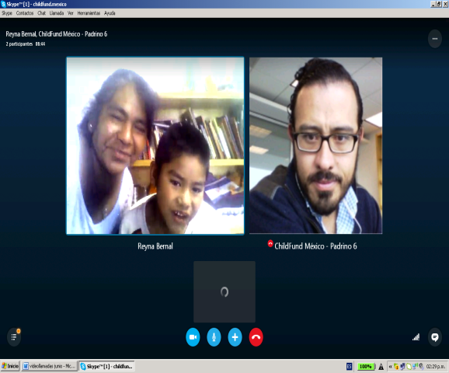
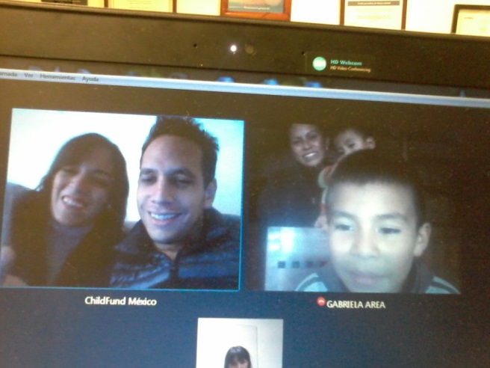
Sponsors Engagement- Skype calls
FY16: 59 video calls – all with national sponsors
FY17 (YTD): 52 video calls with national sponsors
+ 2 with international sponsor so far.
Every time we mention this service to prospects they seem very enthusiastic about it.
Notes:
Today I’d like to talk about how we arrived at this strategy – our process; reiterate our beliefs, vision, mission and core outcomes; talk about a changing world – some of the trends we see that shaped our strategy; our destination 2020 and our strategy to reach it; and our Balanced Scorecard, the tool we will use to help us stay on track to reach our destination.

Slide 5
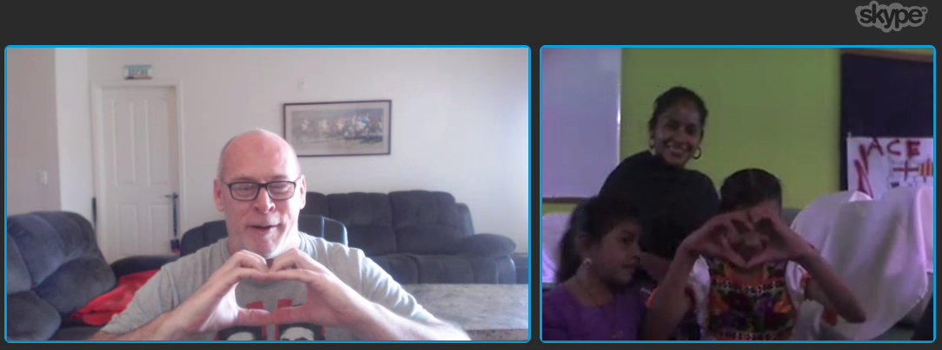
Sponsors Engagement- Skype calls
Benefits:
Direct communication
Alternative to “physical” encounter between sponsor and sponsored child
Innovative
Enrich both sponsor and child experience
Limitations:
Logistics (cost, coordination efforts)
Connection issues or unavailability of internet access for some LPs
Time zones with international sponsors
Translation issues with international sponsors
Pilot with international sponsor:
Notes:
Today I’d like to talk about how we arrived at this strategy – our process; reiterate our beliefs, vision, mission and core outcomes; talk about a changing world – some of the trends we see that shaped our strategy; our destination 2020 and our strategy to reach it; and our Balanced Scorecard, the tool we will use to help us stay on track to reach our destination.

Slide 6
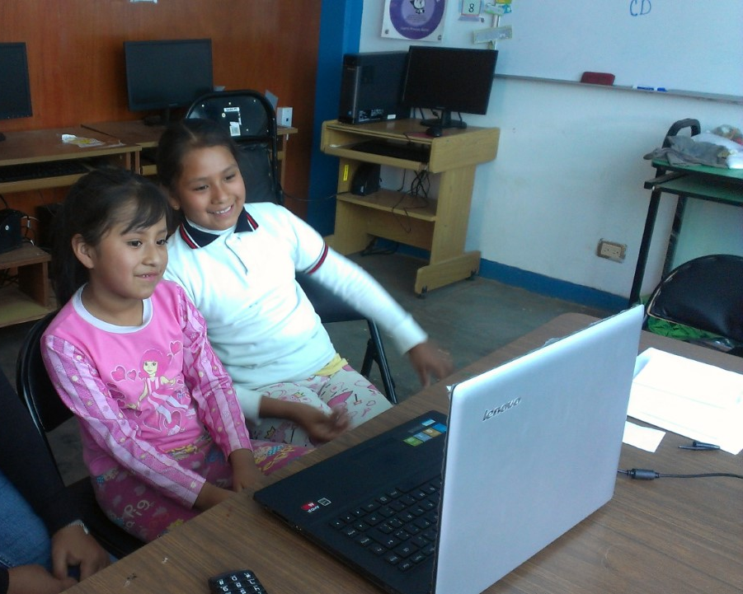
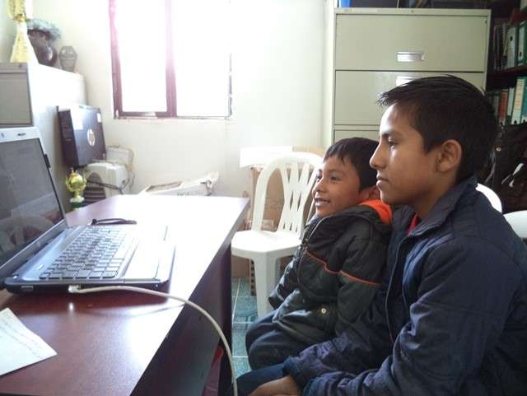
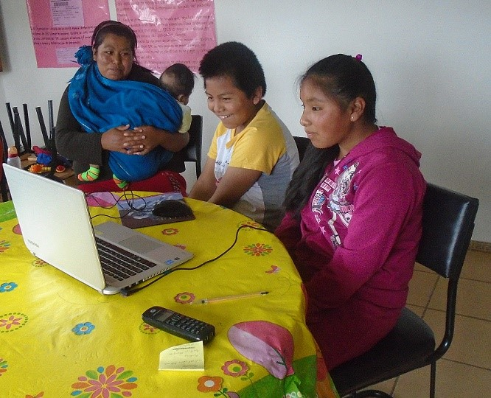
Sponsors Engagement- Skype calls
"Seeing the person through a video call is something the children are not prepared for, but in the course of the conversation they loose fear, I think it was a great experience for Silvestre" LPs Educator, May 2016.
“Thanks a lot for making this possible" Sponsor, February 2017.
"Maria Jose could not sleep from the excitement of the video call with her sponsor" Mom, January 2017.
Notes:
Today I’d like to talk about how we arrived at this strategy – our process; reiterate our beliefs, vision, mission and core outcomes; talk about a changing world – some of the trends we see that shaped our strategy; our destination 2020 and our strategy to reach it; and our Balanced Scorecard, the tool we will use to help us stay on track to reach our destination.

Slide 7

THANK YOU!
We would be happy to hear from you!
Sonia Bozzi - sbozzi@childfund.org
Marco Hernandez– mahernandez@childfund.org

Slide 8
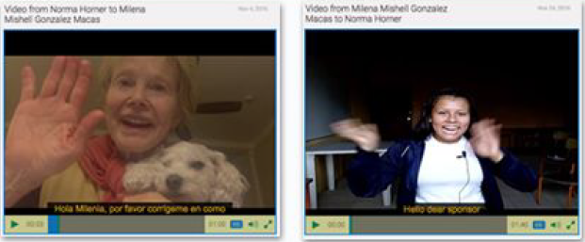
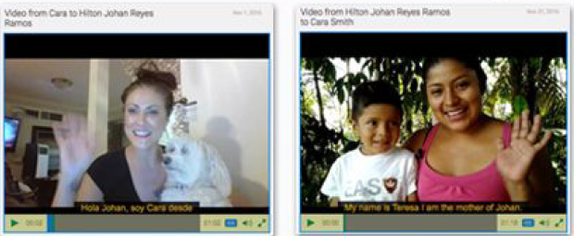
Americas Region
Alternative Presence
Video Communication Pilot

Slide 9
Video Capture Process Overview
Download app to device
Account required
Choose Letter-type
In future, integrated w/ LTE/Bridge
View Tutorial
Optional
Review The Talking points
Optional
Record Video (review/ re-record)
CMS-adjustable length
Upload to CMS
Caption/Translate/Review
In DotSub Interface or customized w/ API
Send To Sponsor
Not yet implemented
Notes:
https://cfi.propelitapp.com/cpanel/conversation.html?ctId=147
http://cfi.propelitapp.com/cpanel/conversation.html?ctId=133

Slide 10
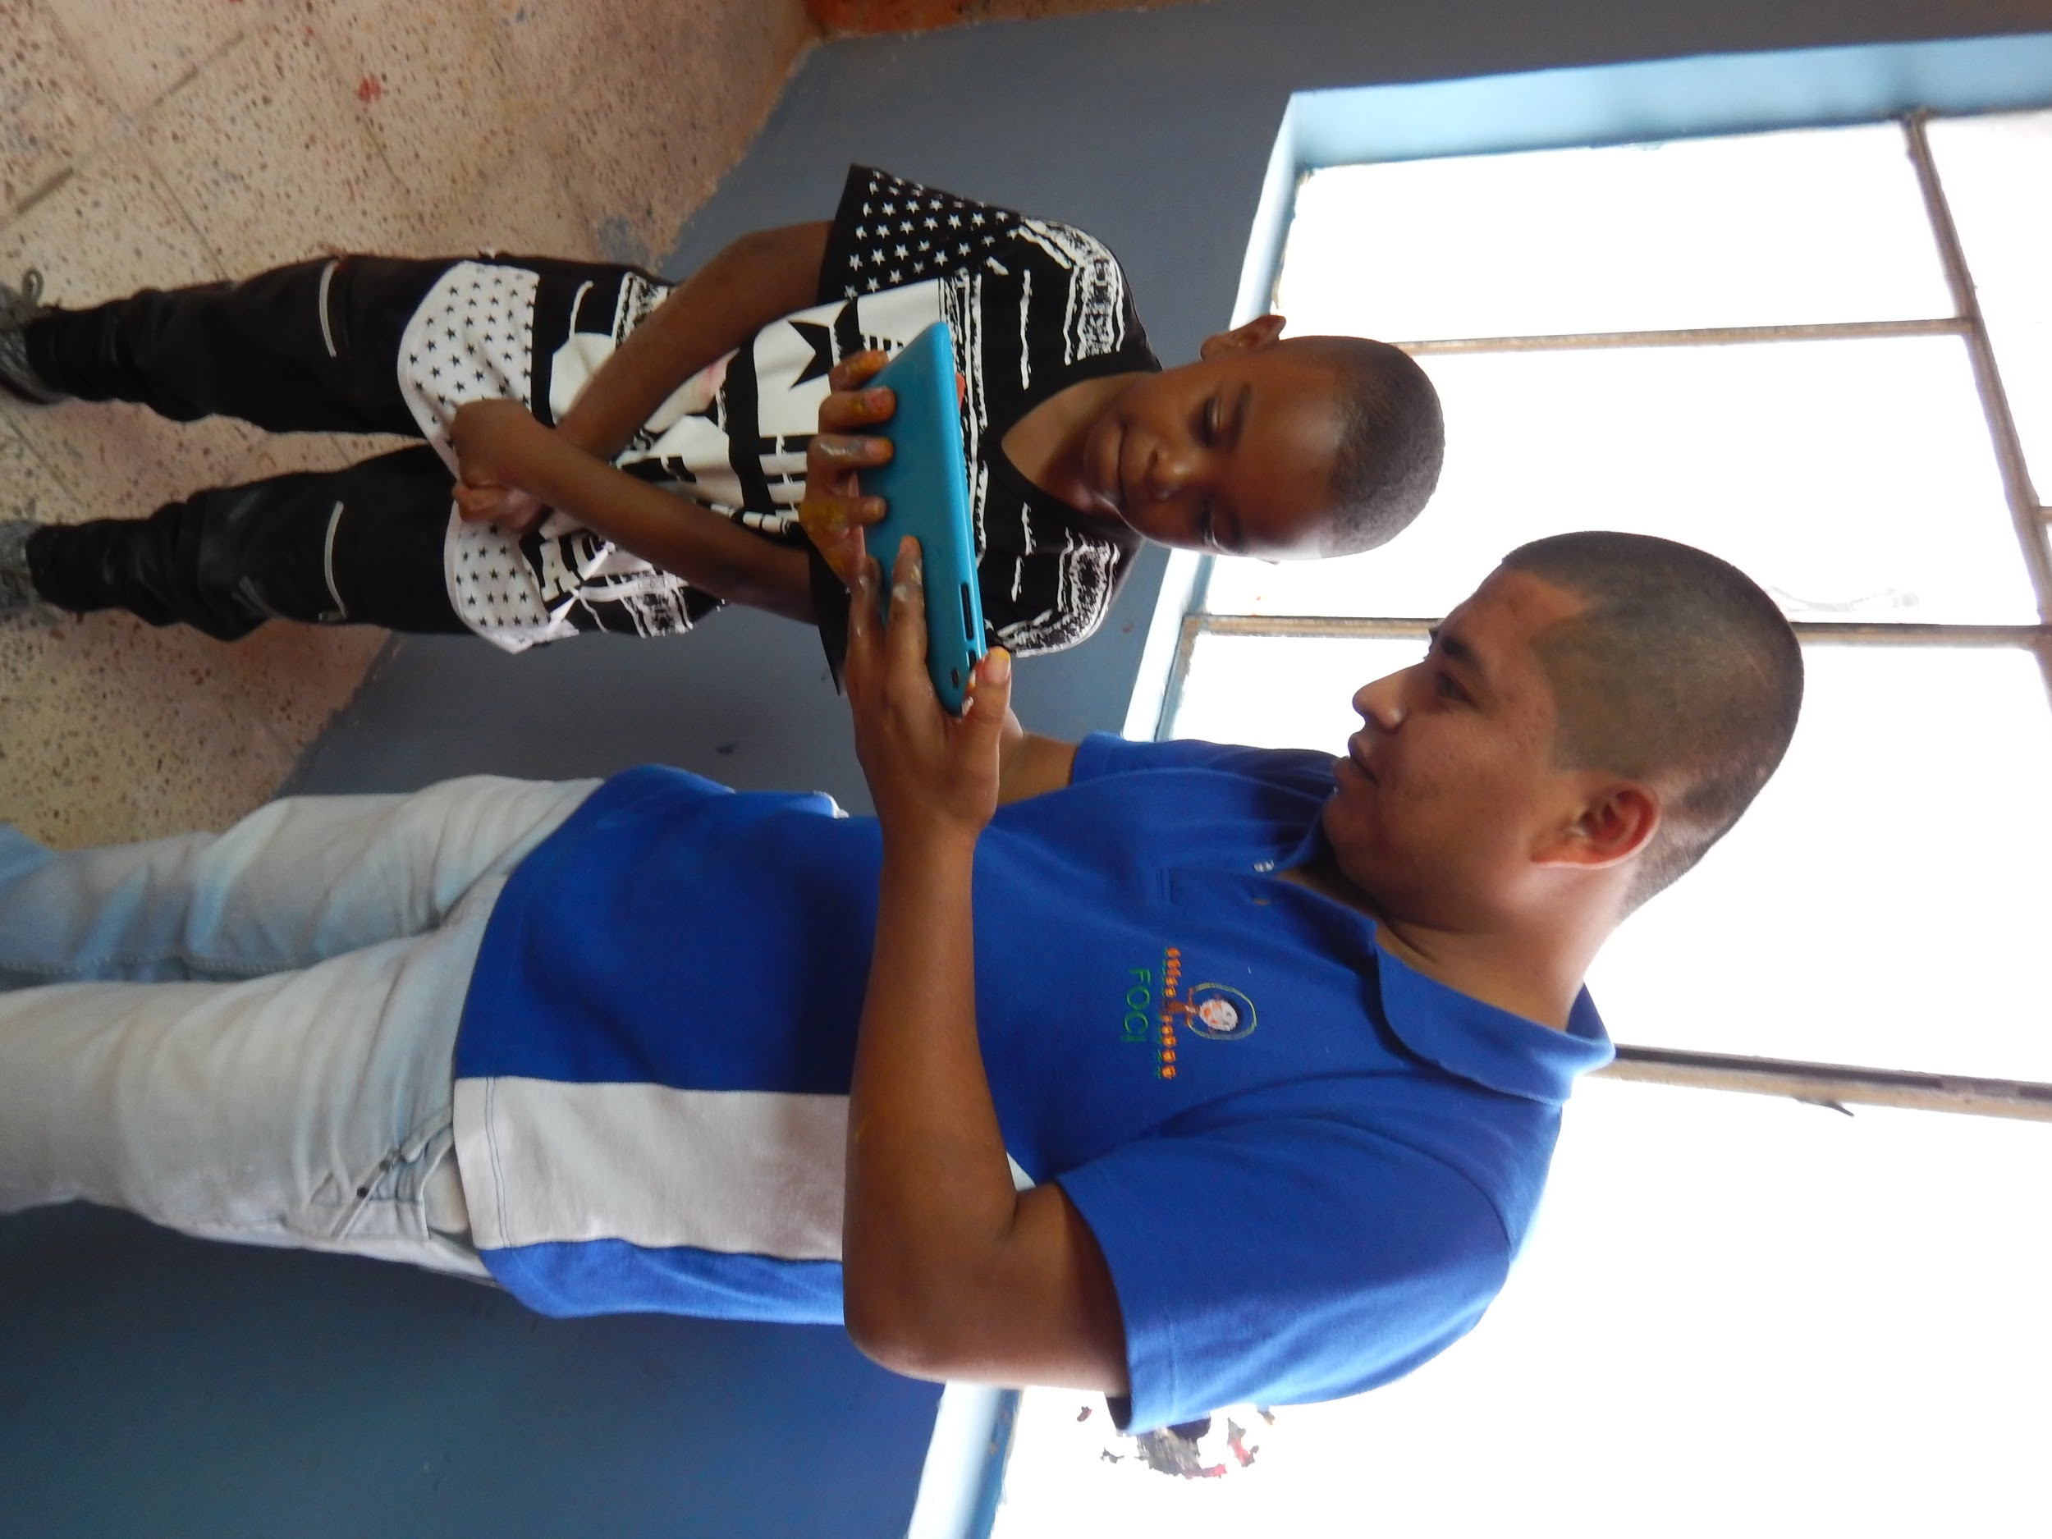
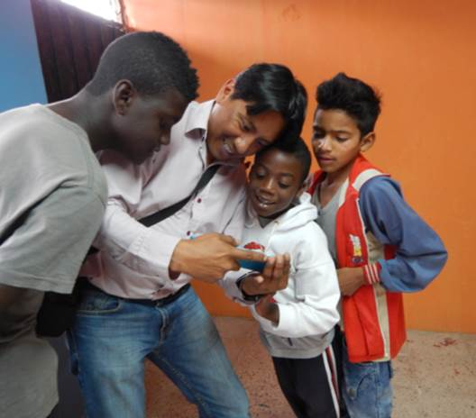
Phase 1
  Bolivia - test 50 children's response to video from a sponsor
Notes:
https://cfi.propelitapp.com/cpanel/conversation.html?ctId=147
http://cfi.propelitapp.com/cpanel/conversation.html?ctId=133

Slide 11
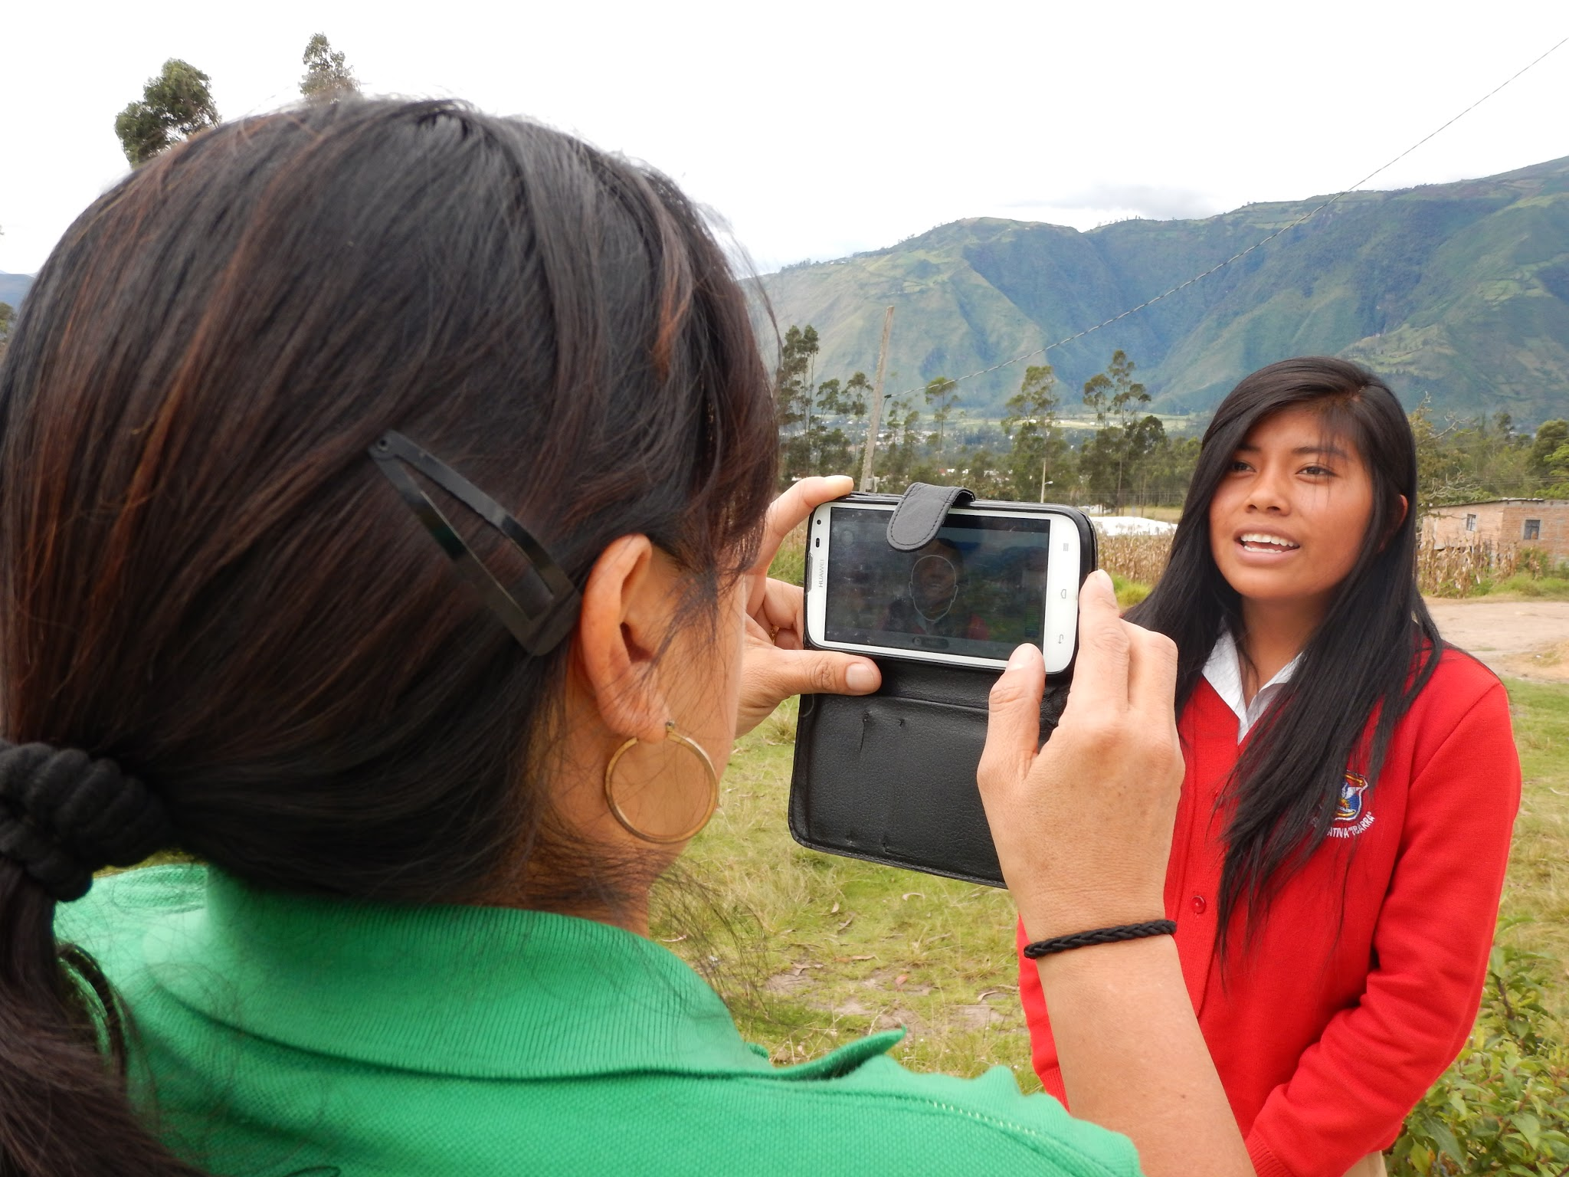
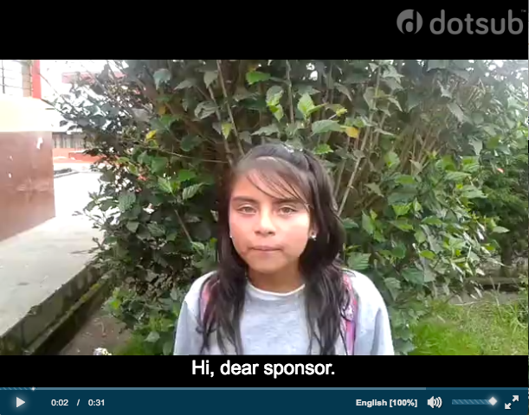
Phase 2
Offered to 500 Bolivian Sponsors:
  26 take up the offer
  Positive response.
  Costs comparable to letter writing

Slide 12
Next Steps - Phase 2.5
Ecuador in negotiations with supplier.
  Offer to 3,000 sponsors
  3-6 months long
Measures for Success and Further roll out:
  Uptake rate exceeds letter writing.
  Frequency of use
  Impact on donation behavior (retention, extra giving )
  Total cost: time, software, translations, on-going support
Phase 3 – systems integration in to bridge
Phase 4: Potentially Zambia and Philippines
Could us as one to many communication e.g. CEO to Sponsors
Notes:
2.5 – hey we have quick video from your child – click this link to get a reaction from sponsor
15%-20% uptake rate
Previous was tested in a busy period Halloween to election

