Slide 1
‘Thank-You Letter’
Campaign
Date: 2018.04.09
Communication and Marketing Committee

Slide 2
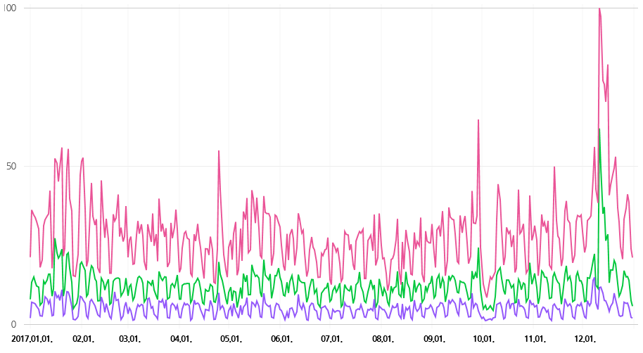
SEO(Search Engine Optimization) in 2017
Female(all ages)
· Issuing donation receipts
· Thank-you letter campaign
· Campaign for sick children
Male(all ages)
· Gift request issue

Slide 3
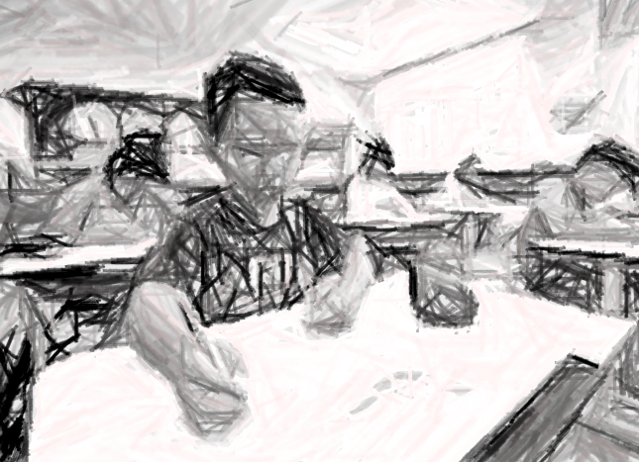
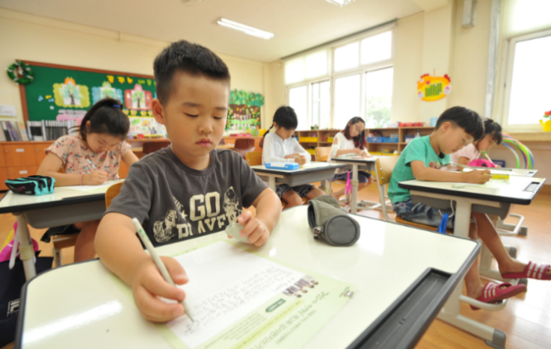
ChildFund Korea
‘Thank-You Letter’ Campaign A. Campaign Overview B. 2017 Campaign Resources & Video clips c. Campaign Results
2018 Campaign Plan A. 2018 ‘Thank-you letter’ promotion B. Goals
ChildFund Korea

Slide 4
‘Thank-You Letter’
Campaign

Slide 5
ChildFund Korea/ ‘Thank-you Letter’ Campaign
Campaign Overview
Step 1. Contest
In 2017, a total of 60,005 students took part in a ‘Thank-you letter’ contest
(1.05.2017 – 31.07.2017)
Step 2. Award Ceremony
176 major awards, including the Education Minister’s Award,
and 500 nominations awarded to a total of 678 students

Slide 6
ChildFund Korea/ ‘Thank-you Letter’ Campaign
Campaign Overview
Subject
01
Express gratitude by writing a letter (to parents, teachers and friends)
- Parents who are always supportive
- Grandparents taking care of a child for one’s parents
- Teachers who praise and give advice
- Teachers who help find talents and make dreams come true
- Friends who are loyal and supportive
Target
Elementary and middle school students and teenagers
02
Goal
The Green Umbrella fosters character development
in the younger generation
03
Aim to improve communication between children and adults
who have lost respect due to lack of communication

Slide 7
ChildFund Korea/ ‘Thank-you Letter’ Campaign
Campaign Process
* Proposal of the chairman of a screening committee
* Approval of the listing of government agencies
and companies
* Receiving letters and building DB
* Distributing kits to schools that apply
* Encouraging schools to participate
* Holding the awards ceremony(30.12.2017, Seoul City Hall)
* Results report
* Receiving and screening letters
(by online or mail)

Slide 8
ChildFund Korea/ ‘Thank-you Letter’ Campaign
Awards list
Award | Personnel | Prize
Education Minister’s Award | 6 | Scholarship US$1,000
Health and Welfare Minister’s Award | 4
Culture, Sports and Tourism Minister’s Award | 4
Gender Equality and Family Minister’s Award | 2
Superintendent of Education Award(17곳) | 67 | Scholarship US$700
Youth Activities Promotion Agency Award | 10 | Scholarship US$500
MBC President’s Award | 10
Munhwa Ilbo Chairman’s Award | 10
Other Partners’ Awards | 20
Childfund Korea Award | 10
Participation Award | 50 | Scholarship US$300
Special Award-Group Award | 3 schools | A School Support Fund US$3,000
Nomination Award | 500 | Souvenir and certificate

Slide 9
ChildFund Korea/ ‘Thank-you Letter’ Campaign
Screening Committee
 | Composition | Schedule | Evaluation Standard
1차 | College Student and Green Umbrella Professional Workers (50 people) | 8/16-18 | Selection based on the fidelity and freshness of the contents
2차 | College Students, Green Umbrella Professional Workers (about 28 people) | 8/30 | Grading based on appropriateness of the intention, fidelity to the contents, and novelty (Out of 200)
3차 | The chairman of the screening committee : 1 person(a university professor) The screening committee: 6 people (Retired teacher/ Foundation director/ university professor/ writer etc. | 9/11-20 (Send results by mail) | Grading based on appropriateness of the intention, fidelity to the contents, and novelty (Out of 100) Selecting the winners according to their score ranking

Slide 10
ChildFund Korea/ ‘Thank-you Letter’ Campaign
TV Commercial
‘Thank You Letter’ Ad

Slide 11
ChildFund Korea/ ‘Thank-you Letter’ Campaign
Online Advertising
‘Thank You Letter’ Ad

Slide 12
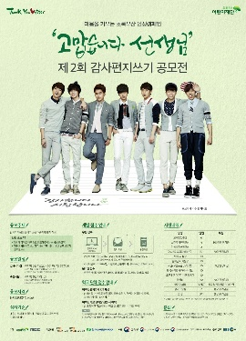
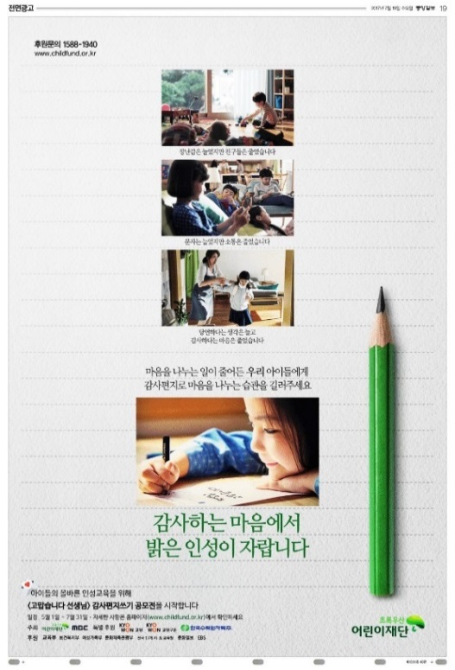
ChildFund Korea/ ‘Thank-you Letter’ Campaign
PR Resources
<Poster>
<Newspaper ad>

Slide 13
ChildFund Korea/ ‘Thank-you Letter’ Campaign
PR Channel
Online
Offline
Homepage
Social Media
Partner Websites
Viral Channels
TV and Newspaper Ads
Broadcasting Partners(Radio Ads and Broadcasts)
Newspaper Partners(Ads and Articles)
Materials for Schools(Posters and Kits etc.)

Slide 14
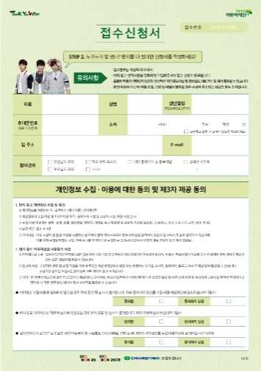
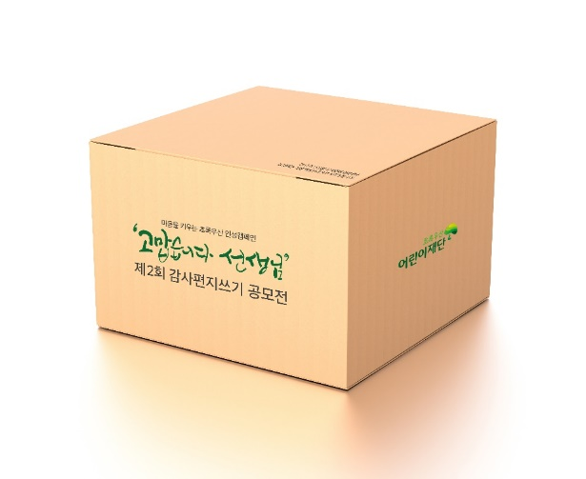
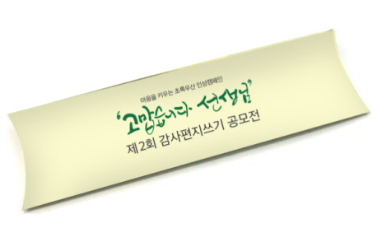
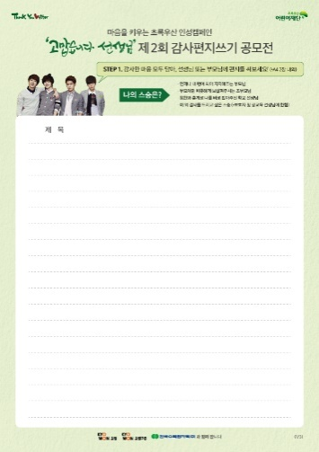
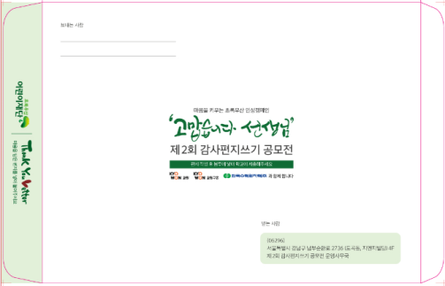
ChildFund Korea/ ‘Thank-you Letter’ Campaign
By Mail
<Delivery Box>
<Pencil>
<Application Form and Paper, Envelope>

Slide 15
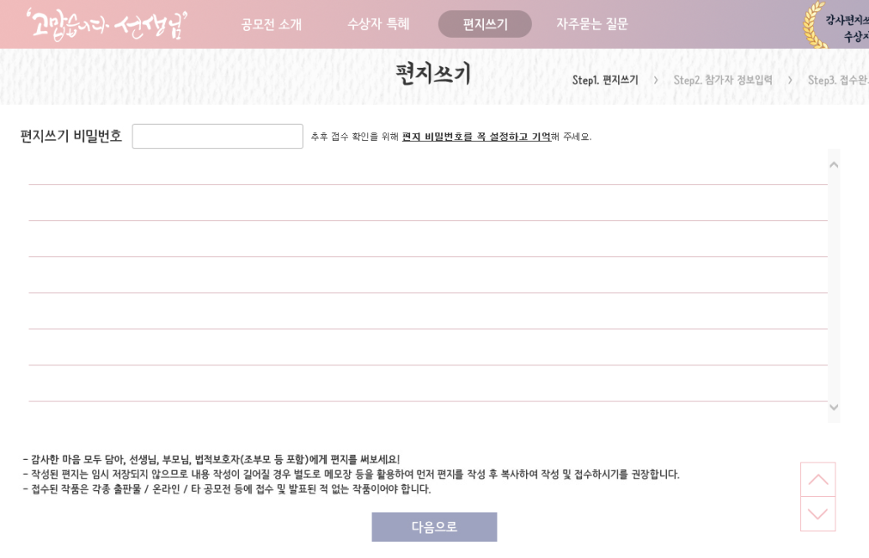
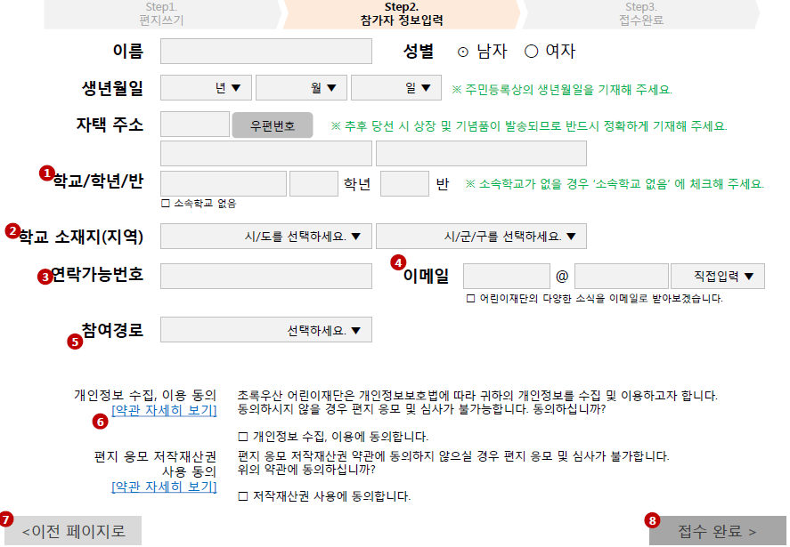
ChildFund Korea/ ‘Thank-you Letter’ Campaign
By Online
<Step 1. Write a letter>
<Step 2. Enter personal information>

Slide 16
ChildFund Korea/ ‘Thank-you Letter’ Campaign
* Results(05.2017 – 07.2017)
A. Participants: 60,005
B. Press Releases: 807

Slide 17
ChildFund Korea/ ‘Thank-you Letter’ Campaign
Results
※ Unit: person
30,982
60,005
194%
increase

Slide 18
2018 Campaign Plan

Slide 19
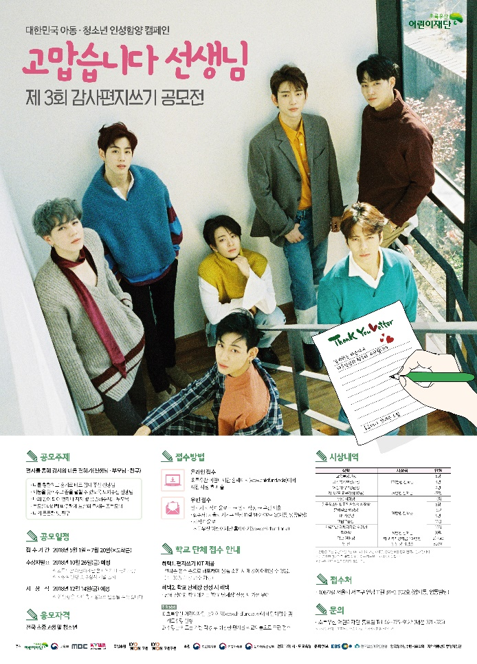
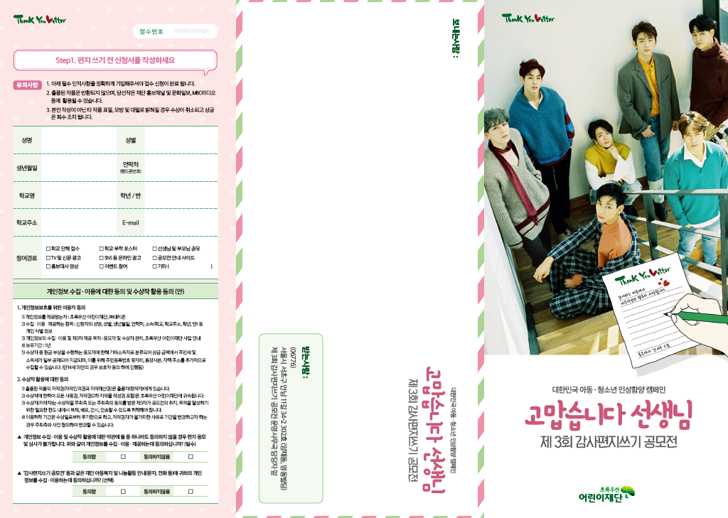
ChildFund Korea/ ‘Thank-you Letter’ Campaign
Resources
<Poster>
<Application form>

Slide 20
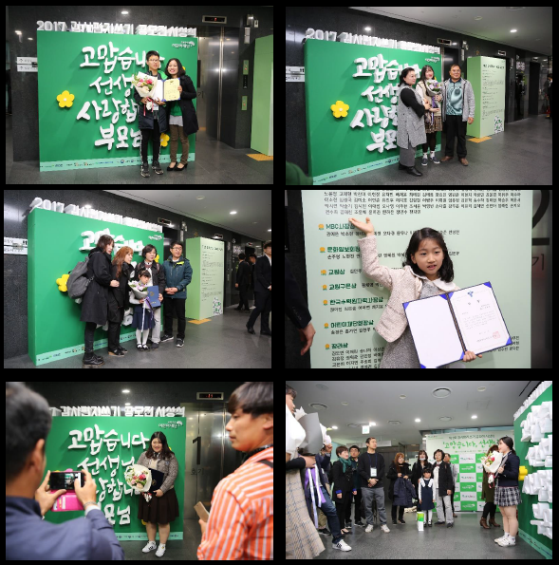
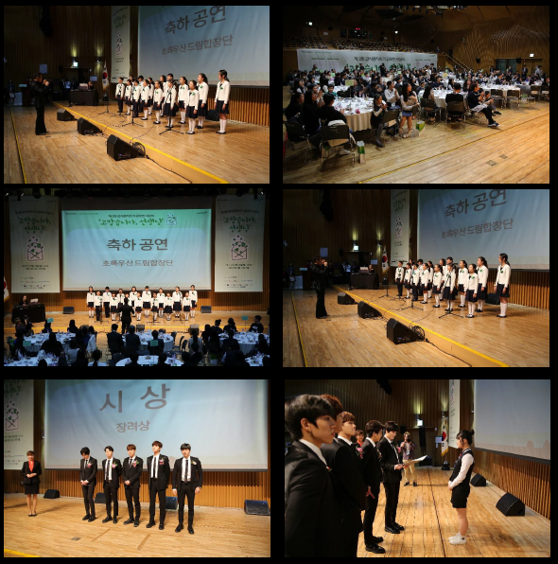
ChildFund Korea/ ‘Thank-you Letter’ Campaign
Award Ceremony
14.12.2018/ Seoul City Hall

Slide 21
ChildFund Korea/ ‘Thank-you Letter’ Campaign
C
Video clip of the ceremony
2017 Award Ceremony

Slide 22
ChildFund Korea/ ‘Thank-you Letter’ Campaign
Goal
※ Unit: person
60,005
100,000
166%

Slide 23
Q & A

Slide 24
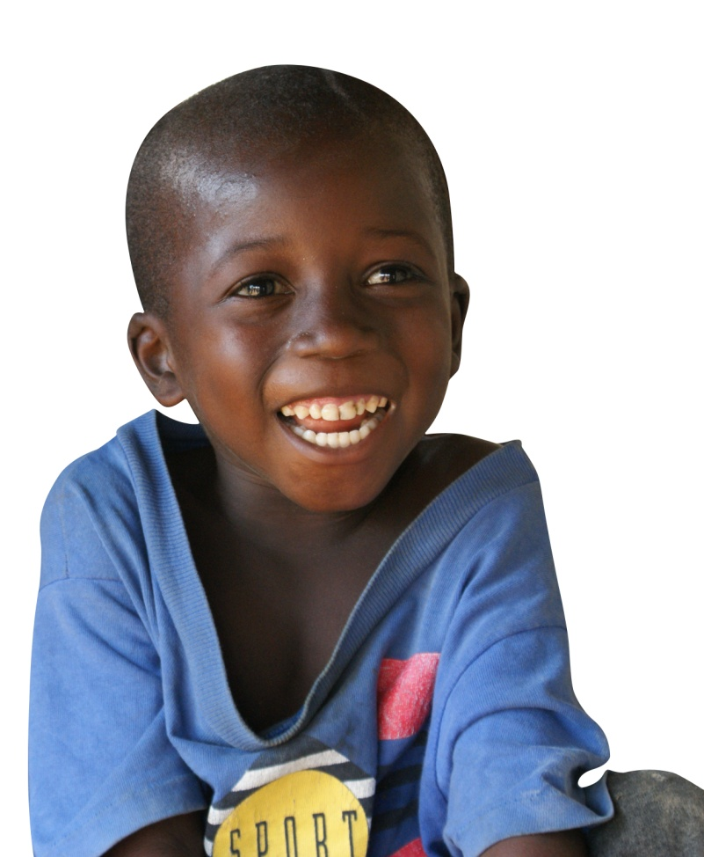
ChildFund Korea
ChildFund Korea has 70 years of stories in its history.
Our transparency makes our work more trustworthy
ChildFund Korea is putting forth its best effort for transparent accounting management, organization operation, and an accountable business report.
Our financial operations are audited by relevant agencies including MPMG and the Ministry of Health and Welfare to ensure our transparency.
We are a member of ChildFund Alliance
ChildFund Korea would like to cover more children in need with a green umbrella. Since 2002, we have been a member of ChildFund Alliance to reach more children worldwide.
We are known as ‘Green Umbrella’ in Korea, and internationally
as ‘ChildFund Korea.’

Slide 25
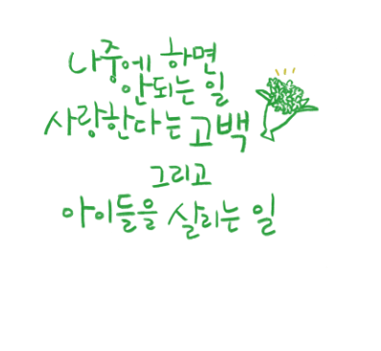
Yoonmi Jung Assistant Director Marketing & Fundraising Dept. +82.2.775.9122(ext.345) ymjung@childfund.or.kr www.childfund.or.kr

